Slide 1
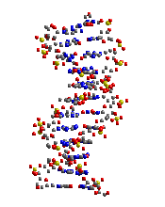
Fundamentals of Genetics
Mendel’s Legacy
Genetic Crosses

Slide 2
GENETICS is the field of Biology devoted to understanding how characteristics are transmitted from Parents to Offspring.
Blending Concept of Inheritance (Before Mendel): This theory stated that offspring would possess traits intermediate between those of different parents. (Red and white flowers produce pink)
Traits = different physical characteristics (like height, color, etc in pea plants)

Slide 3
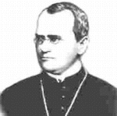
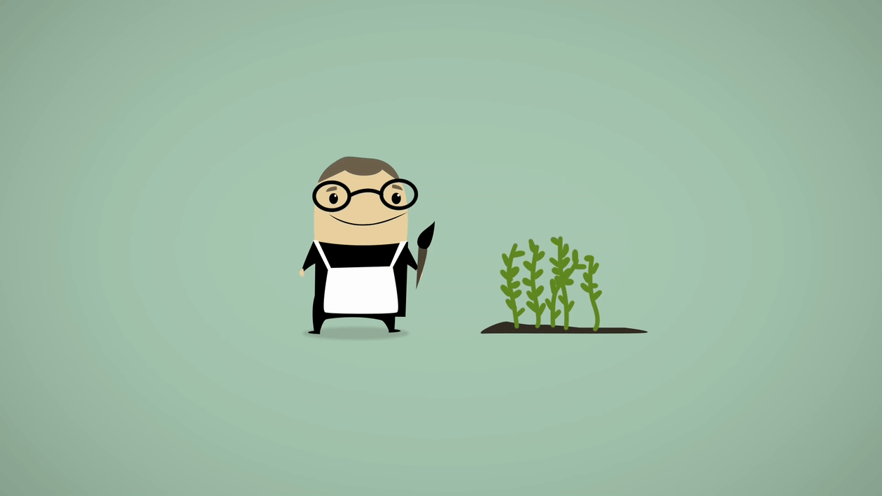
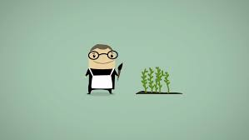
Gregor Mendel : Austrian monk who studied science and mathematics (statistics) and formulated two fundamental laws of heredity in the early 1860's.

Slide 4
Mendel's Garden Peas = Pisum sativum He used his knowledge of Statistics to analyze his observations of the seven characteristics of garden peas. Mendel traced inheritance of individual traits and kept careful records of numbers.

Slide 5
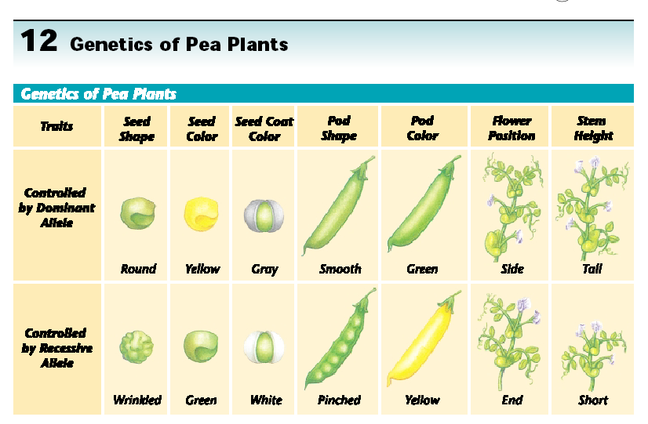

Slide 6
Mendel’s Methods : carefully controlling how the pea plants were Pollinated.
Purebred = plants with traits that always produce offspring with that trait.
Strain = plant (organism) that is pure for a specific trait
Hybrid = the offspring of parent organisms that are purebred for different forms of one trait.

Slide 7
Parental P1 Generation = the parental generation in a breeding experiment.
F1 generation is the first-generation offspring in a breeding experiment. (1st filial generation)
From breeding individuals from the P1 generation.
F2 generation is the second-generation offspring in a breeding experiment. (2nd filial generation)
From breeding individuals from the F1 generation

Slide 8
Labeling Generations

Slide 9
Mendel’s Conclusions: from statistical analysis he hypothesized that the traits must be carried by some form of “factors” that:
Pairs is how they occur
Segregate in gamete production (sperm / egg)
Independently sort out from one another

Slide 10
Mendels 3 Laws
1. Law of Segregation: In the formation of gametes, the chromosome number drops from diploid to haploid.
2. Law of Independent Assortment: as chromosomes separate they do so randomly
3. Law of Recombination: Separate haploid gametes reunite at the time of fertilization to restore the chromosome number to diploid

Slide 11
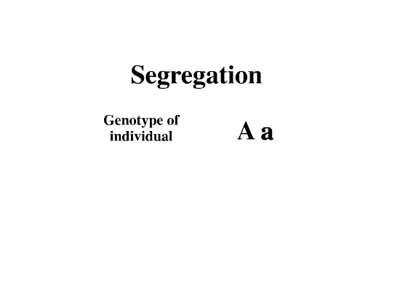

Slide 12
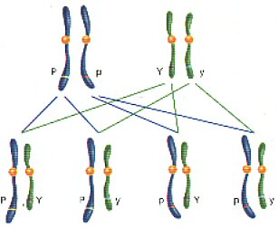
Segregation & Independent Sorting

Slide 13
Modern Molecular Genetics Matches Mendel’s Predictions:
Sutton: (1903) used a microscope to discover that chromosomes were the factors Mendel predicted.
A Gene is a segment of DNA on a Chromosome that controls a particular hereditary trait. Chromosomes occur in pairs, so genes also occur in pairs.

Slide 15
Genetic Terms
Dominant: Prevailing factor
Recessive: non prevailing factor
Diploid: complete chromosome number
Haploid: half chromosome number
Homozygous: both factors on homologous chromosomes are the same
Heterozygous: both factors on homologous chromosomes are different

Slide 16
Genetic Terms
Genotype: genetic make up of the cell
Phenotype : outward appearance expressed by gene
Human male: XY Human female: XX
Humans have:
2 sex chromosomes: 1pair
44 Autosomes: 22 pairs
46 total chromosomes: 23 pairs

Slide 17
Alleles = several alternative forms of a gene. Mendel’s Factors are now called alleles.
Letters are used to represent Alleles:
Capitals refer to a Dominant Allele that masks or hides expression of a recessive allele.
Lowercase refers to a Recessive Allele its expression is masked by a dominant allele.

Slide 18
Dominant vs. Recessive
Dominant Factor because it masked, or dominated the other factor for a specific trait
Recessive Factor = the other trait that did not appear when paired with a dominant trait.

Slide 19
Examples of Symbols
In pea plants, tall is dominant so a capital “T” is used for the dominant tall allele.
Short is recessive so a lowercase “t” is used for the short allele.
A purebred tall pea plant would be: TT
A purebred short pea plant would be: tt
A hybrid tall pea plant would be: Tt

Slide 20
Genetic Crosses
Genotype consists of the alleles that the organism inherits from its parents. Phenotype is the appearance of an organism as a result of its genotype.
Homozygous is when both alleles of a pair are alike (TT) or (tt). * Same as “purebred”.
Heterozygous is when the alleles of a pair are different (Tt). * Same as “hybrid”.

Slide 21
Probability
Probability is the likelihood that a specific event will occur or is the likely outcome a given event will occur from random chance.
With each coin flip there is a 50% chance of heads and 50% chance of tails.
Chance of inheriting one of two alleles from a parent is also 50%.

Slide 22
Probability =
Number of times an event is expected to happen Number of opportunities for an event to happen

Slide 23
Monohybrid Cross is a cross between individuals that involves One Pair of Contrasting Traits * Example PP x pp
Punnett Square is a tool to calculate probable results of a genetic cross. All possible types of sperm alleles are lined up vertical and all possible egg alleles are lined up horizontally, so that every possible combination can be shown in squares.

Slide 24
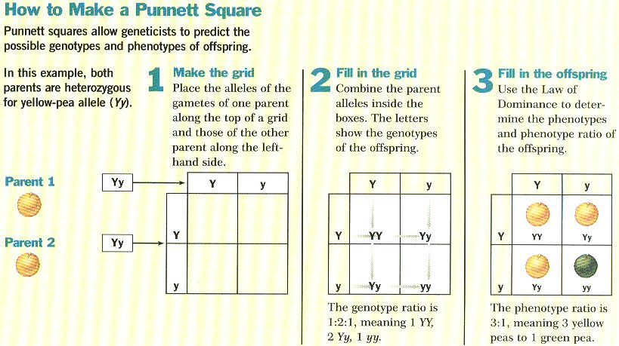

Slide 25
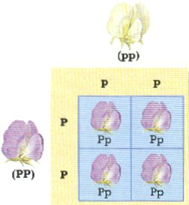
HOMOZYGOUS X HOMOZYGOUS * 100% probability that the offspring will be (Tt)

Slide 26
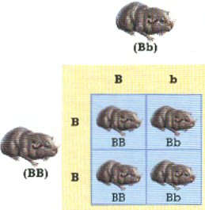
HOMOZYGOUS X HETEROZYGOUS * 50% TT; 50% Tt

Slide 27
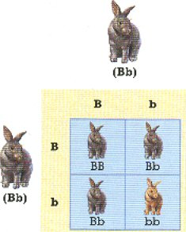
HETEROZYGOUS X HETEROZYGOUS * 25% TT; 25% tt; 50% Tt

Slide 28
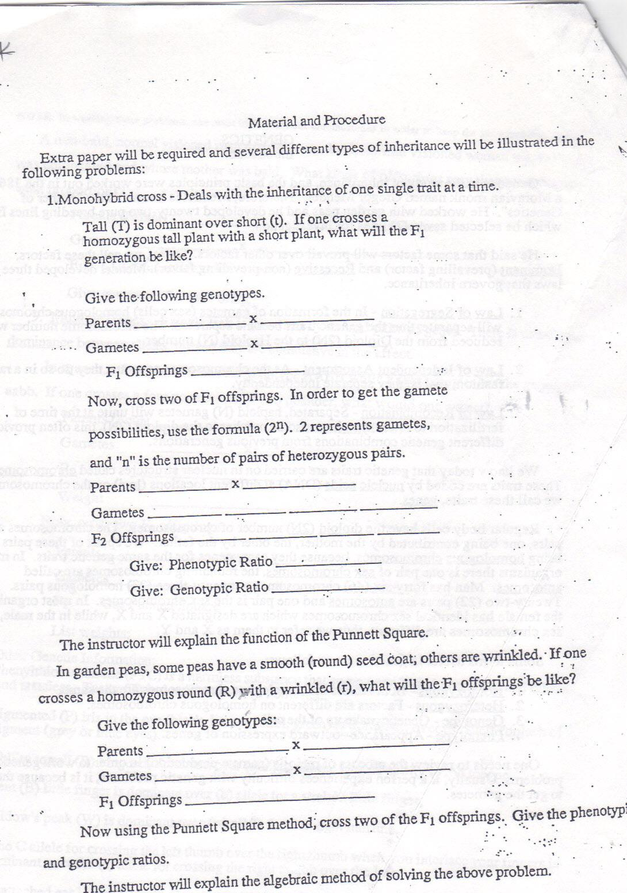

Slide 29
Complete Dominance is when one allele has complete dominance over another.
Peas (T) tall dominant over (t) short
Incomplete Dominance occurs when two or more alleles influence the phenotype, resulting in a phenotype intermediate between the dominant trait and recessive trait.
Red flowers x White flowers produce Pink flowers
Codominance ( multiple Alleles) occurs when both alleles for a gene are expressed in a heterozygous offspring.
White guinea pig x black guinea pig produces a black and white offspring.

Slide 30
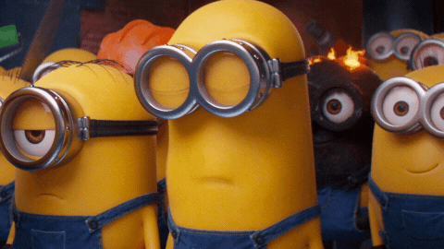
Incomplete dominance
In a heterozygous organism, neither gene is dominant, both genes are expressed equally
Capital letters used for both alleles
Snap dragons- red = RR, white= WW, pink = RW
Cows- brown = BB, white= WW, roan=BW

Slide 31
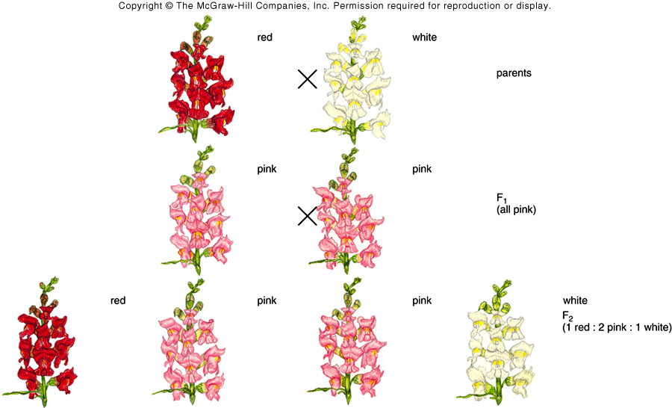
Incomplete dominance

Slide 33
A testcross is used to determine the genotype of an unknown individual.
A dihybrid cross is a cross between individuals that involves TWO Pairs of Contrasting Traits.

Slide 34
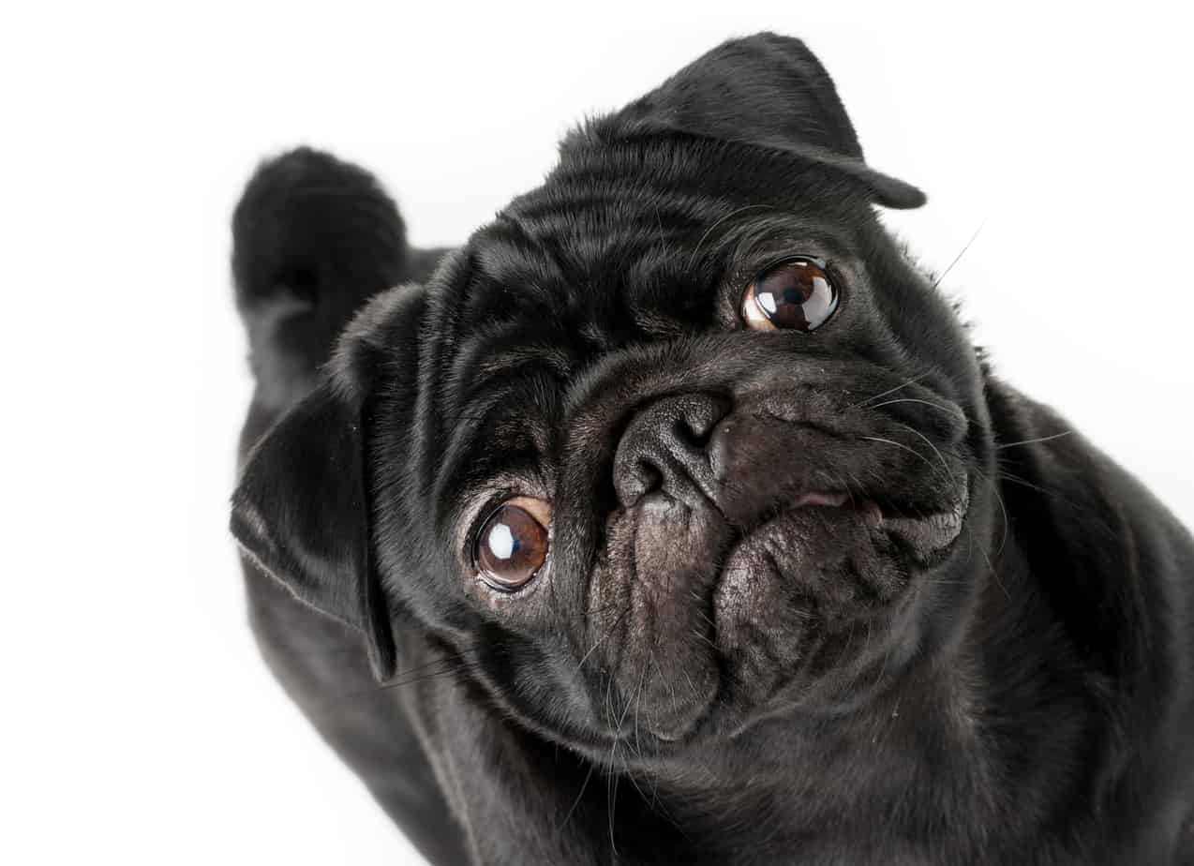

Slide 38
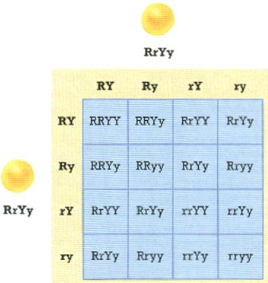

Slide 39
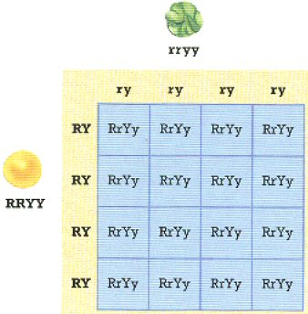

Slide 40
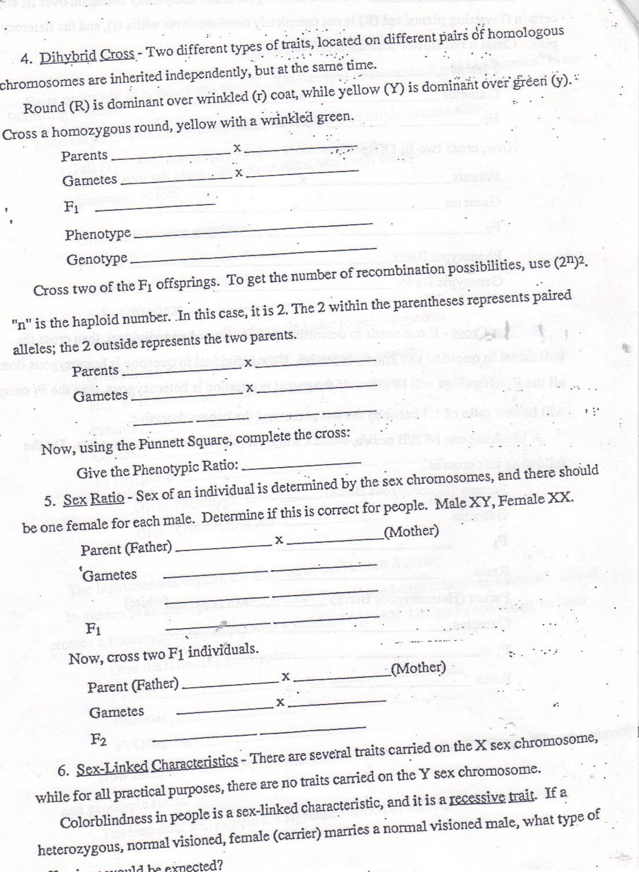

Slide 41
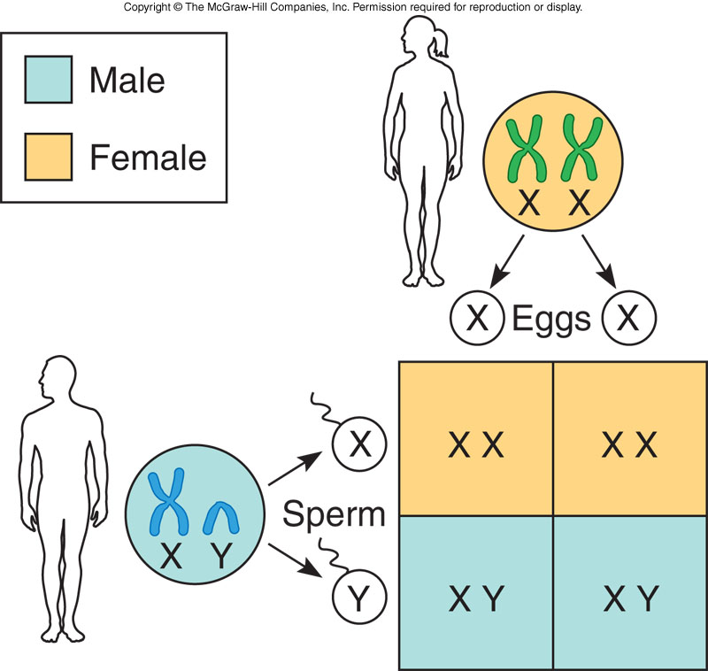
Sex Determination in Humans
Figure 6.6
Figure 6.6

Slide 43
Inheritance related to sex
Genes located exclusively on the x chromosome are called sex-linked
Genes that occur only on the Y chromosome can produce their effects only in males and are called Holandric genes
The mechanisms where a given trait is limited to one sex is called sex-limited.
If the dominance of a given allele depends on the sex of the bearer is called sex-influenced.

Slide 44
Sex-Limited Traits
Traits that affect a structure or function occurring only in one sex
The gene may be autosomal or X-linked
Examples:
- Beard growth
- Milk production
- Preeclampsia in pregnancy
Notes:
44

Slide 45
Y-linked Traits
Genes on the Y chromosome are said to be Y-linked
Y-linked traits are very rare
Transmitted from male to male
No affected females
Currently, identified Y-linked traits involve infertility and are not transmitted
Notes:
45

Slide 47
X-linked Traits ( we will do some examples on the board
Possible genotypes
X⁺X⁺ − Homozyogus wild-type female
X⁺X^{m} − Heterozygous female carrier
X^{m}X^{m} − Homozygous mutant female
X⁺Y − Hemizygous wild-type male
X^{m}Y− Hemizygous mutant male
Notes:
47

Slide 49
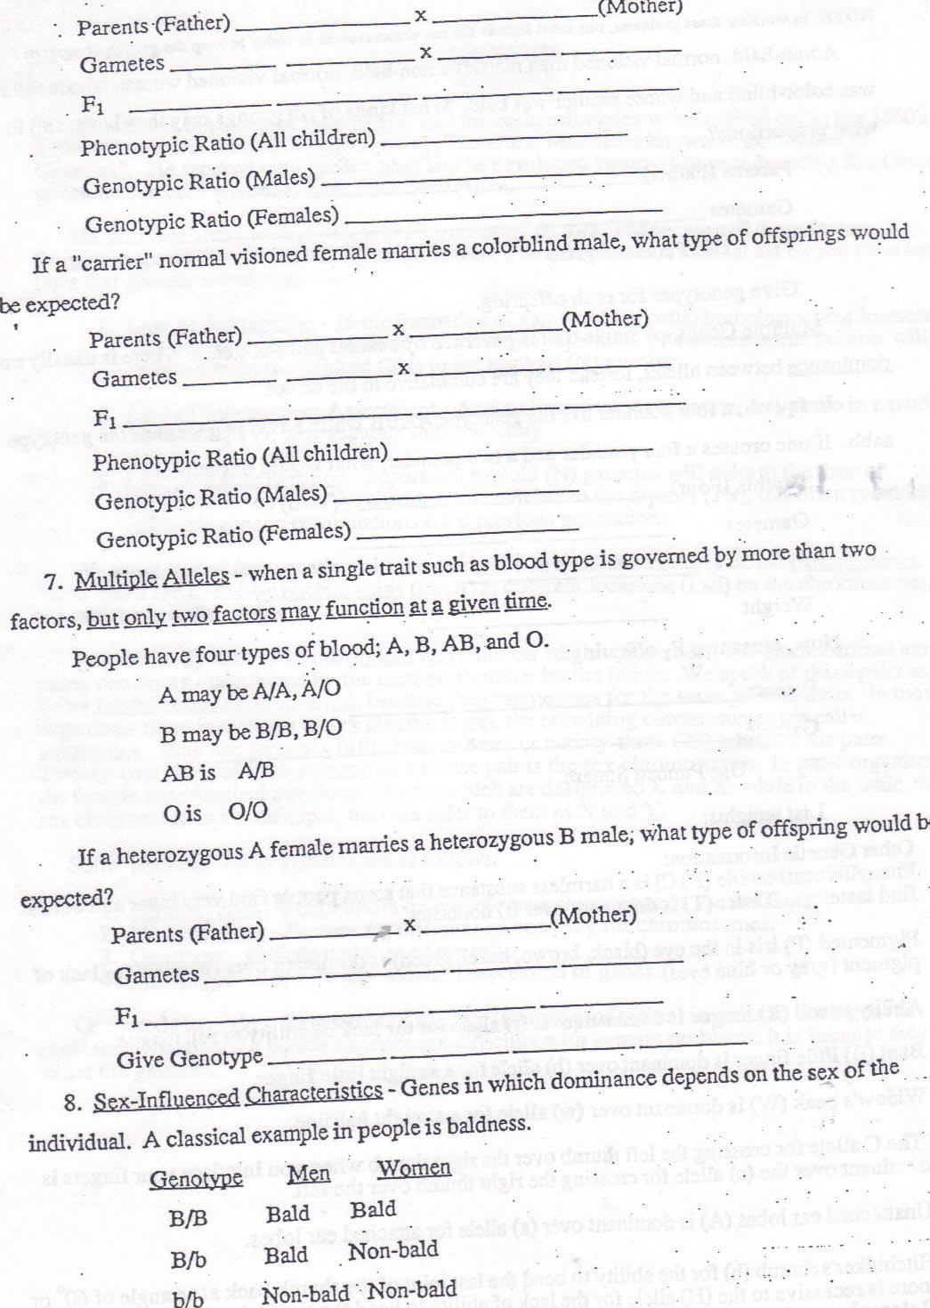

Slide 50
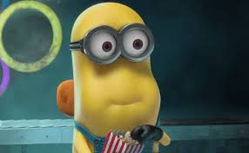
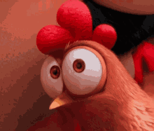
Sex-Influenced characteristics do some examples on board
Genotype male chickens female
HH Hen feathered Hen feathered
Hh Hen feathered Hen feathered
hh cock-feathered Hen feathered

Slide 51
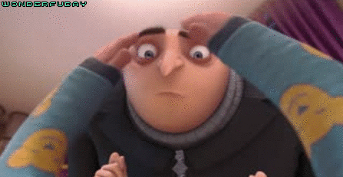
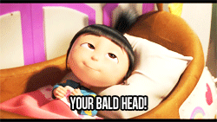
Sex influenced traits
Baldness: do some problems on the board
Genotype Men women
BB bald Bald
Bb bald not
bb not not

Slide 53
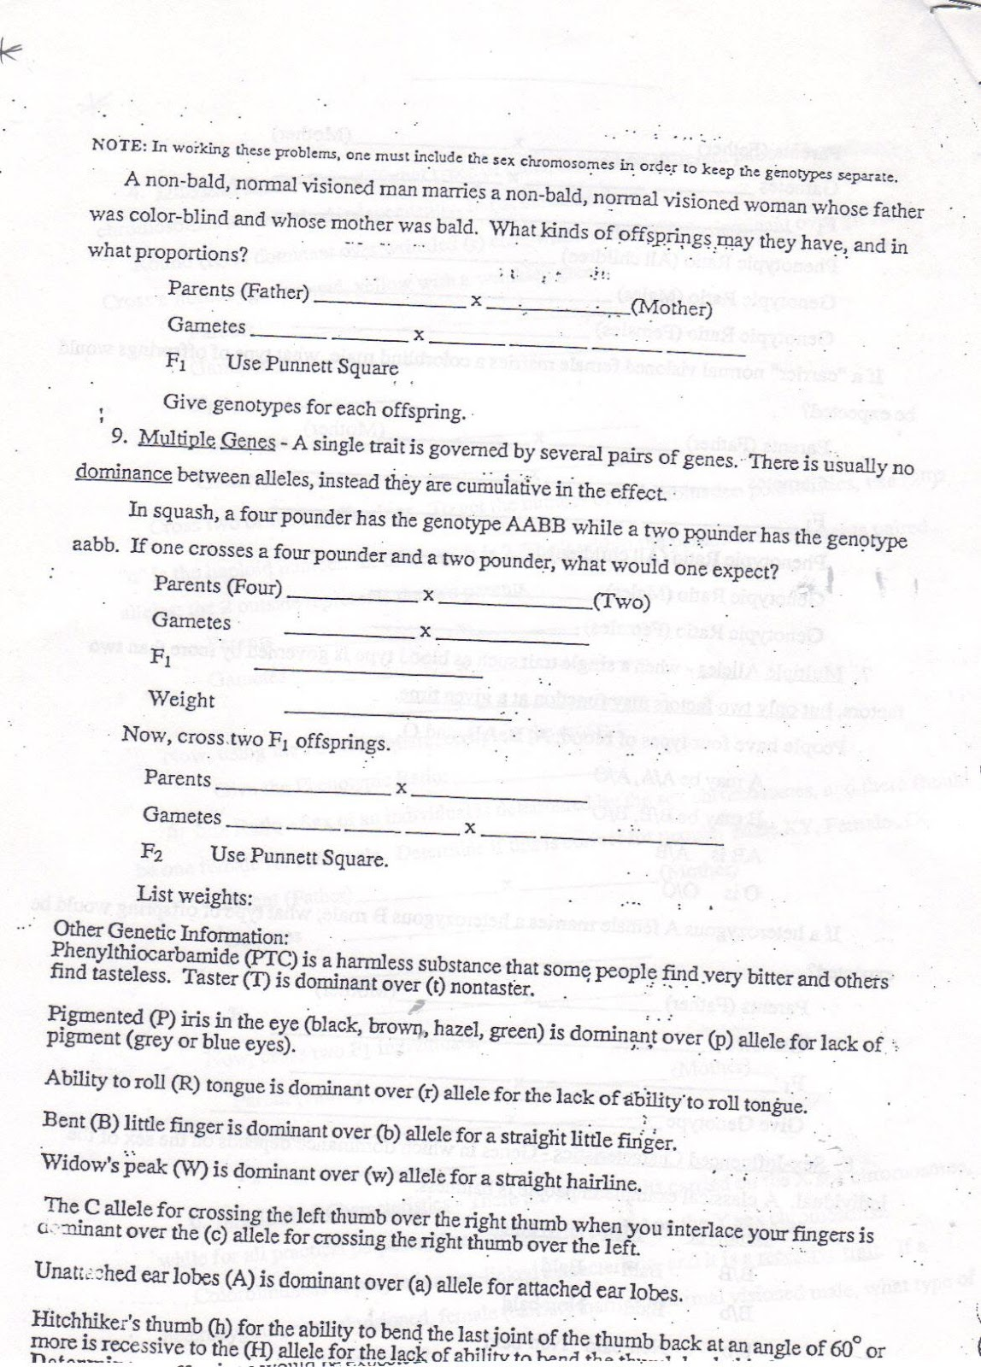

Slide 54
Codominance/ Multiple Alleles
The heterozygous phenotype results from the expression of both alleles
The ABO gene encodes a cell surface protein
- I^{A} allele produces A antigen
- I^{B} allele produces B antigen
- i (I^{O}) allele does not produce antigens
Alleles I^{A} and I^{B} are codominant, and both are completely dominant to i
Notes:
54

Slide 55
Blood Types
Blood Type | Allele Combinations
A | I^{A} I^{A} or I^{A} i
B | I^{B} I^{B} or I^{B} i
AB | I^{A} I^{B}
O | ii

Slide 56
Multiple Gene Traits
are controlled by many genes acting together as a group to produce the visible phenotype.
* Human skin color is controlled by at least three genes.
- Each skin gene has at least two possible alleles at that gene site on the DNA.
- The allele combinations determine the amount of pigment in the skin cells.

Slide 57
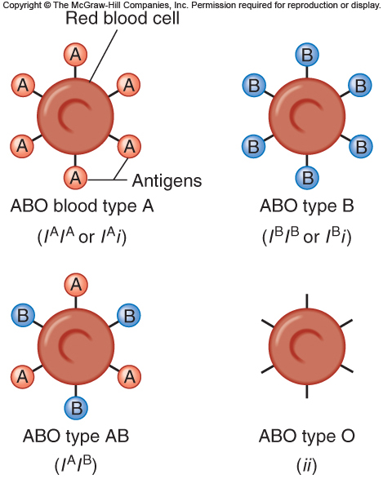
Figure 5.3

Slide 58
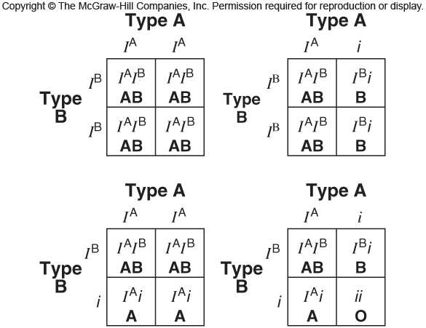
Offspring from Parents with Blood Type A and Blood Type B
Figure 5.4
Figure 5.4

Slide 60
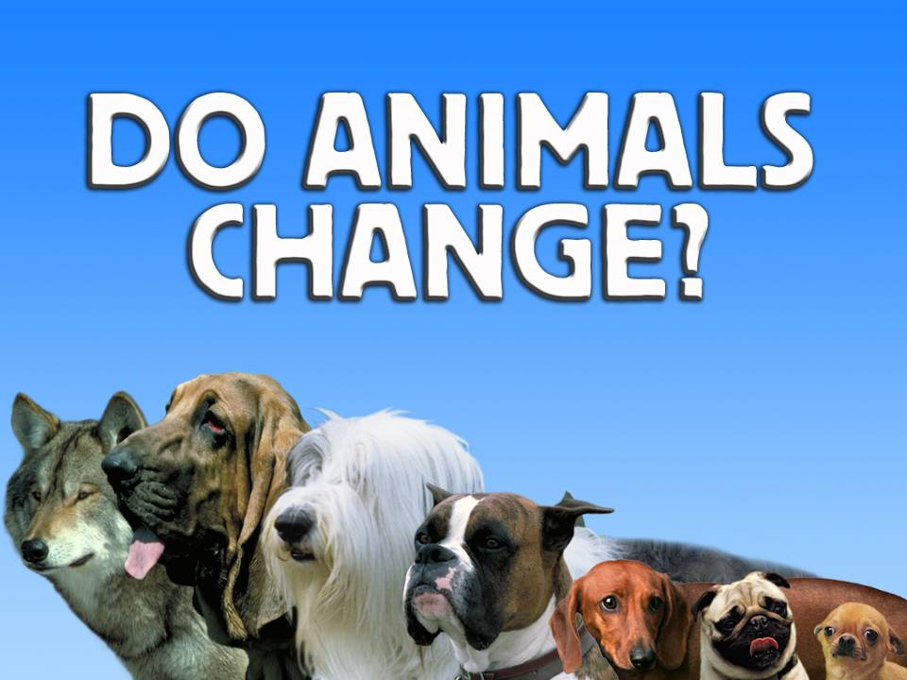

Slide 62
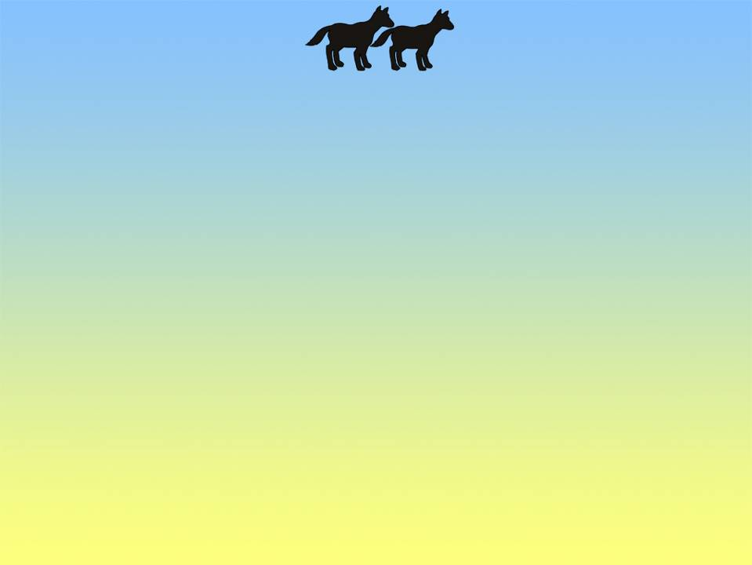
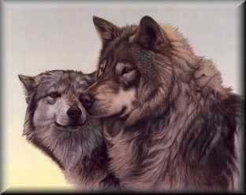
Notes:
new lots of dogs 2004 1.jpg

Slide 63
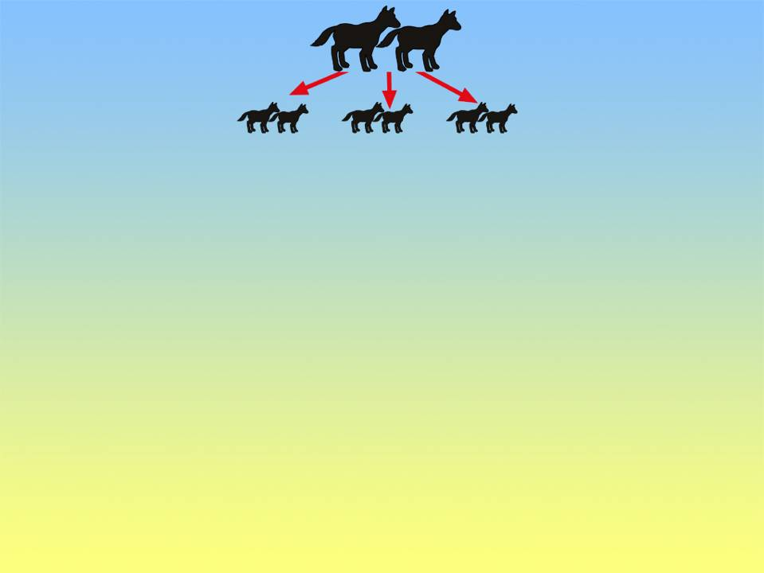
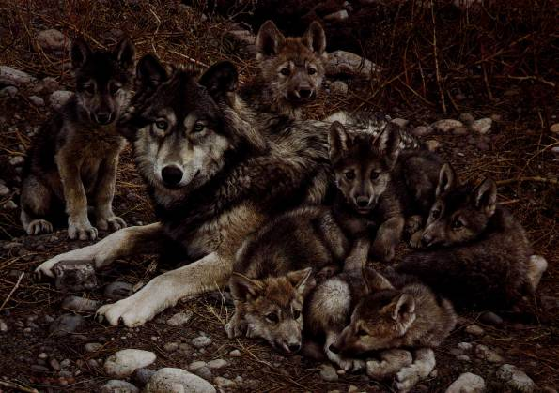
Notes:
new lots of dogs 2004 2.jpg

Slide 64
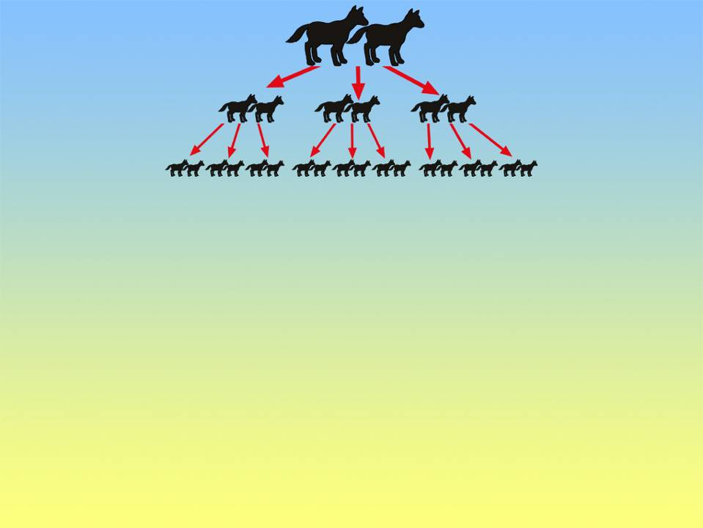
Notes:
new lots of dogs 2004 3.jpg

Slide 65
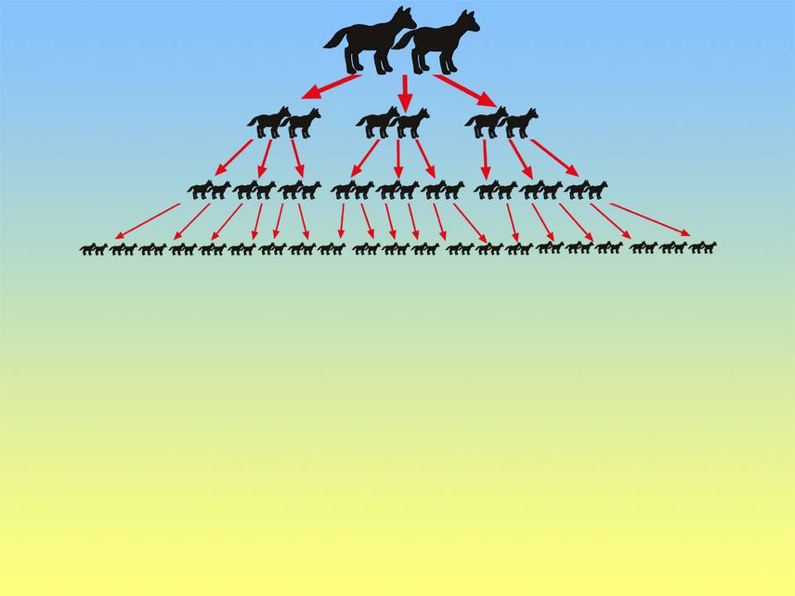
Notes:
new lots of dogs 2004 4.jpg

Slide 66
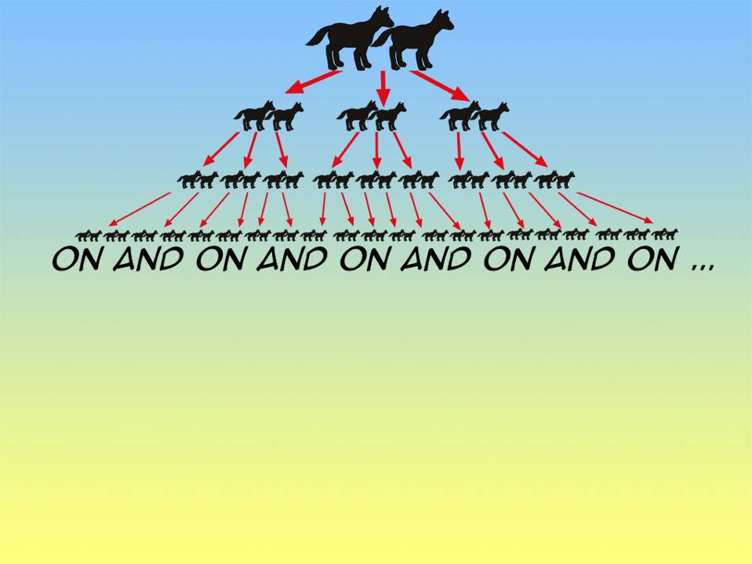
Notes:
new lots of dogs 2004 5.jpg

Slide 67
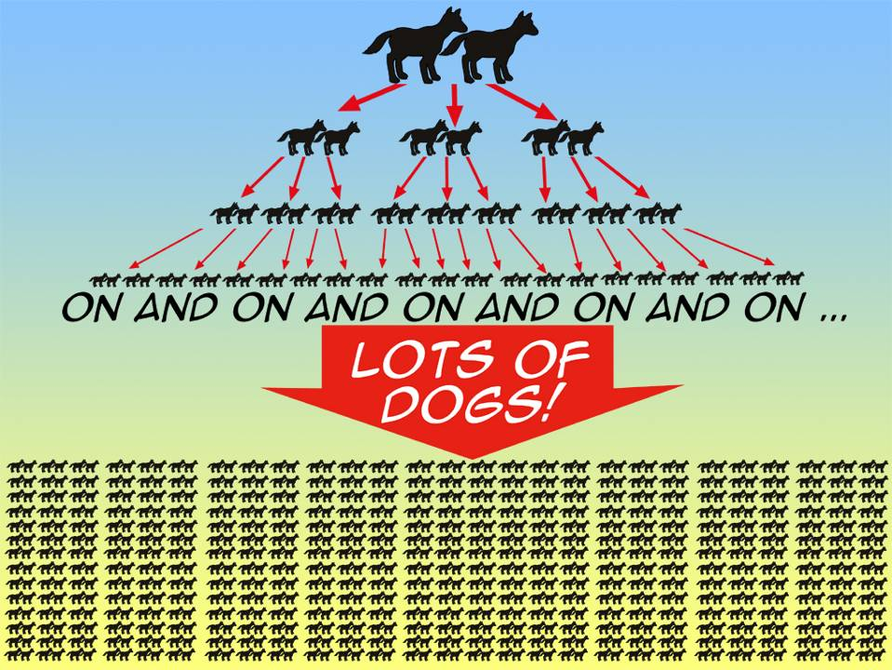
Notes:
new lots of dogs 2004 6.jpg

Slide 68
Dog Kind – no new info

Slide 69
Possible variation - dogs

Slide 70
Possible variation - dogs

Slide 71
Possible variation - dogs

Slide 72
Possible variation - dogs

Slide 73
Possible variation - dogs

Slide 74
Possible variation - dogs

Slide 75
Number of atoms in the Universe :10⁸⁰

Slide 76
Number of electrons that can be fitted into the known Universe: 10¹³⁰

Slide 77
Number of children from one couple without two exactly the same: 10²⁰¹⁷

Slide 78
Noah’s Ark – New Jan 2004

Slide 79
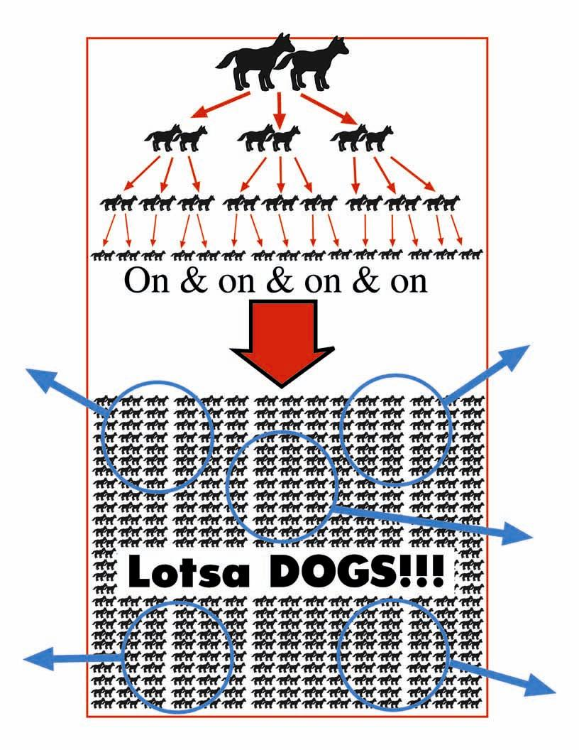
Lotsa Dogs!!! W/circles

Slide 80
Lotsa Dogs!!! W/circles
AB
ab

Slide 81
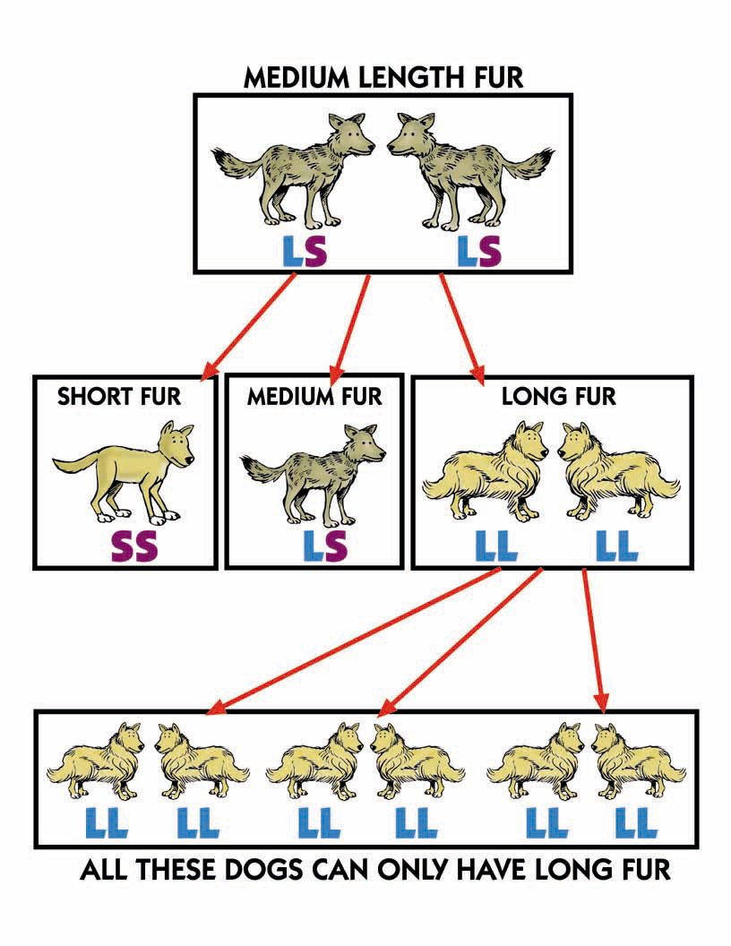
Dog medium fur length

Slide 82
Dogs – Natural Selection Cold/Hot

Slide 83
Dogs – Natural Selection Cold/Hot

Slide 84
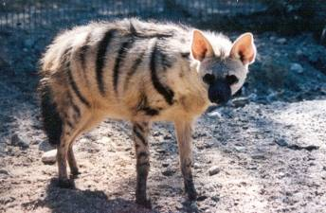
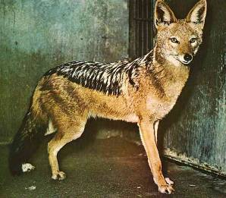
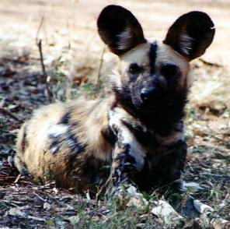
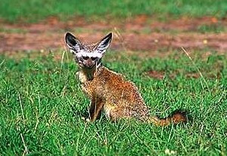
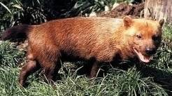
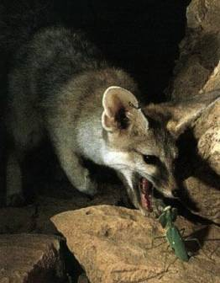
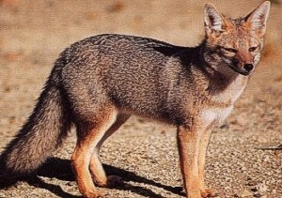
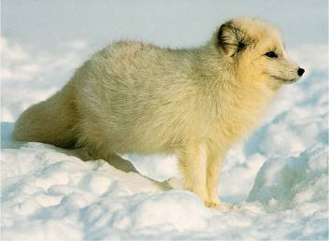
Wild dogs 1
Aardwolf
Black-backed jackal
Bat-eared fox
African wild dog
Wild dogs
Blanford’s fox
Bush dog
Argentine gray fox
Arctic fox

Slide 85
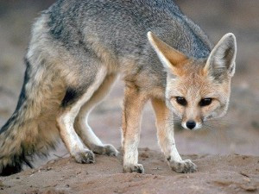
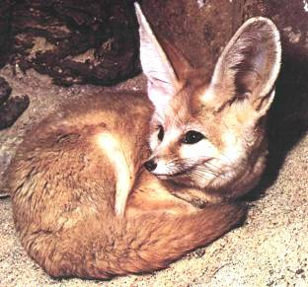
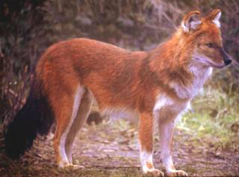
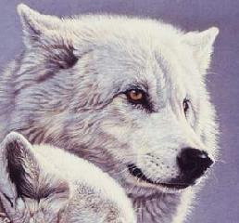
Wild dogs 2
Fennec fox
Dhole
Cape fox
Culpeo fox
Wild dogs
Arctic wolf
Coyote
Corsac fox
Crab-eating fox

Slide 86
Wild dogs 3
Tibetan sand fox
Arctic fox
Falkland Island’s fox
Gray wolf
Wild dogs
Dingo
Golden jackal
Dingo
Ethiopian wolf

Slide 87
Wild dogs 4
Gray fox
Kit fox
Hoary zorro
Wild dogs
Raccoon dog
Small-eared dog
Mexican gray wolf
Sand fox
Maned wolf

Slide 88
Wild dogs 5
Pale fox
Sechuan zorro
Red wolf
Red fox
Wild dogs
Timber wolf
Pampas fox
Iberian wolf

Slide 92
Environmental Effects
– (The organisms surroundings can alter the effect of the genes.)
* Example: Diet can affect height.
- Since 1800’s human height has increased by 10 cm on average.

Slide 93
Pedigree is a chart or “family tree” that tracks which members of a family have a particular trait.

Slide 94
Autosomal dominant pedigree

Slide 95
Human Genetic Disorders
Genetic Disorder = an abnormal condition that a person inherits through genes or chromosomes.
* They are caused by mutations, which are changes in a person’s DNA.

Slide 96
Cystic Fibrosis =
the lungs and intestines fill with mucus.
Sickle-Cell Disease =
red blood cells are shaped like sickles.
Hemophilia =
causes the blood to clot too slowly or not at all.
Huntington’s Disease =
causes the breakdown of brain cells.
Down Syndrome =
an extra copy of chromosome number 21.

Slide 97
Diagnosing Genetic Disorders
Amniocentesis is now used.
- Long needle to get fluid and cells from the baby in the mother’s womb.
- A karyotype (a picture of all the chromosomes in the baby’s cell) is then made
and examined by the doctor.
Genetic Counseling by doctors, helps families predict the possibilities of having a child with the disorder.

Slide 98
Karyotype

Slide 99
Advances in Genetics
Three Methods to Produce Organisms with desirable traits:
Selective Breeding
Cloning
Genetic Engineering

Slide 100
Selective Breeding
A process where scientists select a few organisms with desired traits to serve as parents of the next generation.
Inbreeding = crossing two individuals that have similar sets of alleles. (Used to produce purebred dogs.)
Hybridization = crossing two genetically different individuals. (Used to mix two different desirable traits.) (Like corn that has lots of kernels & is healthy.)

Slide 101
Genetic Engineering
A process where genes from one organism are transferred into the DNA of another organism. It is also called “gene splicing”. Scientists sometimes use viruses to transfer the DNA.
Gene Therapy is a process that tries to correct genetic disorders, by inserting normal (working) copies of the gene into the cells of a person with a disorder.
Genome is a word that for ALL the DNA in one cell or an organism.

