Slide 1
Virtual Skeleton Identification

Slide 2
In this activity, skeletons will be examined for how they vary according to the following:
Gender (based on the pelvis & skull)
Race (based on characteristics of the skull)
Age (based on general characteristics)
Height (calculated based on the length of individual long bones)

Slide 3
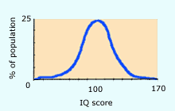
GENDER
There are several things that may, on the surface, be useful to gender determination, but upon closer examination, are not very useful. For example, on average, females are shorter than males, but a short skeleton can easily be male. This is due very simply to the fact that each gender follows a Gaussian distribution (a.k.a. a Bell Curve).

Slide 4
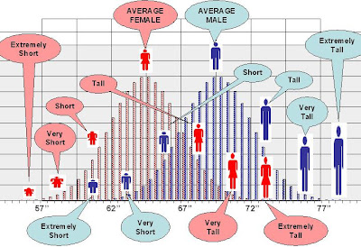
It is easily possible to have a female at the tall end of the height curve, and a male at the short end of the height curve. The curves for gender overlap, for the most part, with the peak of each curve slightly off-set. It is easy to say that the average height is shorter for females than it is for males, but that information is useless when we examine two individual skeletons.

Slide 5
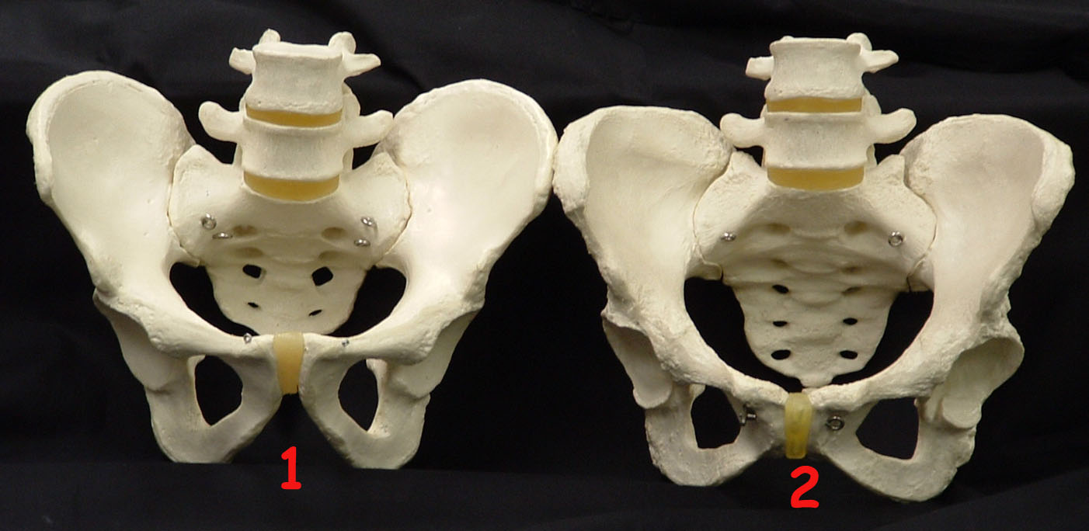
There are several ways to more accurately determine the gender of a skeleton. One of them is by examining the pelvis, which can be identified accurately 95% of the time.
Male Female

Slide 6
Angle of Ischium (sub-pubic angle): Male = 50° - 60° (B) Female = 80° – 85°, can be as much as 90° (A)
Female Male

Slide 7
Sacral Tilt: Male: Tilted backward Female: Tilted forward
Male
Female

Slide 8
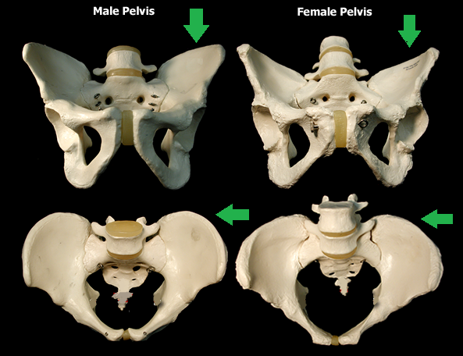
Ilium spread: Male: Lesser Female: Greater

Slide 9
Pelvic Outlet: Male = Narrow (A) Female = Wide (B)
Male
Female

Slide 10
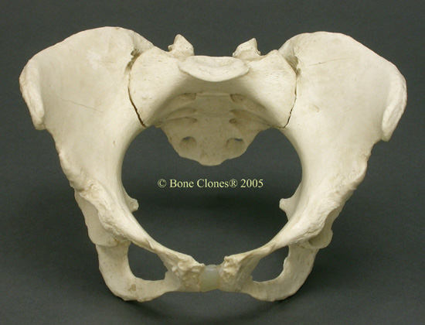
Practice: Pelvis #1
Identify the attributes of this pelvis to find the gender:
Angle
Sacrum
Pelvic
Ilia Close or Spread
Female or Male

Slide 11
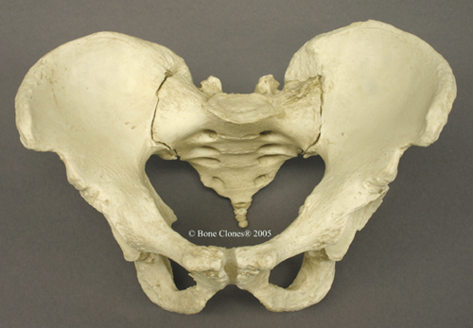
Practice: Pelvis #2
Identify the attributes of this pelvis to find the gender:
Angle
Sacrum
Pelvic
Ilia Close or Spread
Female or Male

Slide 12
Another way is to examine the skull.
This is fairly accurate, but not as accurate as the pelvis.
Forensic anthropologists can accurately identify the skull somewhere between 85 and 90% of the time.
This can be complicated by several factors:
If a skull is incomplete,
Some of the distinguishing characteristics, such as larger bone landmarks for muscle attachments in males, can be easily confused with the landmarks of more athletic females.

Slide 13
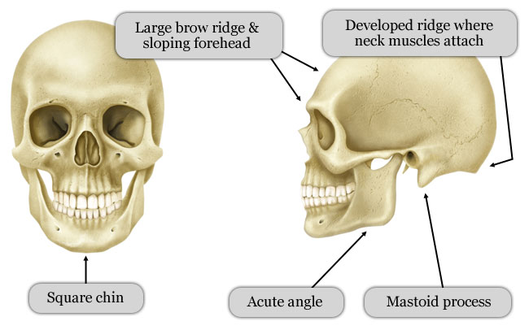
Landmarks | Female | Male
Chin | Rounded | Square
Mastoid Process (Behind Ear) | Small | Large
External Occipital Protuberance (Back of Skull) | Small (Not Prominent) | Large (Prominent)
General Anatomy | Gracile (i.e., Graceful) | Robust
Forehead | Vertical / Rounded | Receding (Careful with the comments . . .)
Brow Ridges (Location of Eyebrows) | Slightly Developed | Prominent
Muscle Lines | Slightly Developed | Prominent
Orbital Margins (Edge of Eye Socket) | Sharp | Rounded
Angle of Ascending Ramus (Back Corner of the Jaw) | Obtuse | Close to 90 degrees

Slide 14
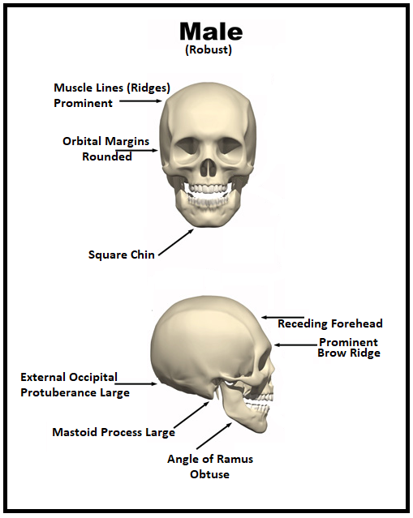
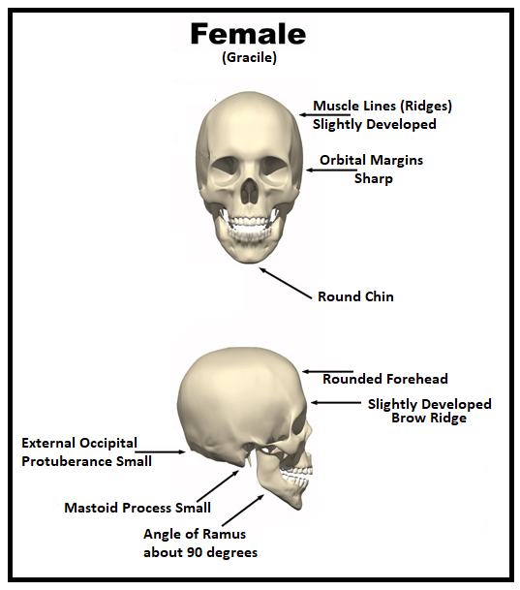

Slide 15
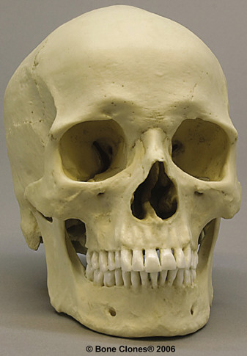
Practice Skull #1
Chin
Mastoid Process
Occipital Protuberance
General Anatomy
Forehead Vertical
Brow Ridges
Muscle Lines
Orbital Margins
Angle of Ramus
Female or Male?

Slide 16
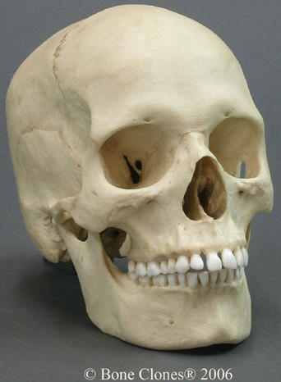
Practice Skull #2
Chin
Mastoid Process
Occipital Protuberance
General Anatomy
Forehead Vertical
Brow Ridges
Muscle Lines
Orbital Margins
Angle of Ramus
Female or Male?

Slide 17
Race:

Slide 18
RACE
There are several features that can be used to determine the race of an individual.
In terms of the skull,
A great place to start is the maxillary bone. The left and right maxillary bones form the roof of the mouth, contain the upper 16 teeth in the adult (the upper 10 teeth in the child), and form the outline of the nasal cavity.
The nasal cavity itself involves several other bones: ethmoid, inferior nasal conchae, lacrimal, nasal, sphenoid, and vomer.

Slide 19
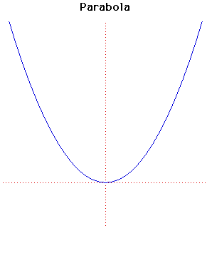
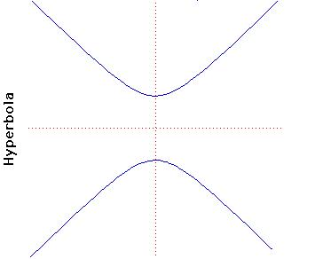
The arch of the maxilla can be found in three basic shapes: hyperbolic, parabolic, and rounded. Each of the the following three races have their own shape:
African = hyperbolic,
European = parabolic,
Asian = rounded.

Slide 20
The incisors
Differ in their basic shape. The incisors fall into two basic categories, based on the shape of the lingual (tongue) surface of the tooth. These two categories are:
(1) shovel-shaped, and
(2) spatulate, or spatula-shaped.
As there is more than one race with spatulate incisors, other indicators are necessary to positively identify race:
(1) African = spatulate,
(2) European = spatulate,
(3) Asian = shovel-shaped.

Slide 21
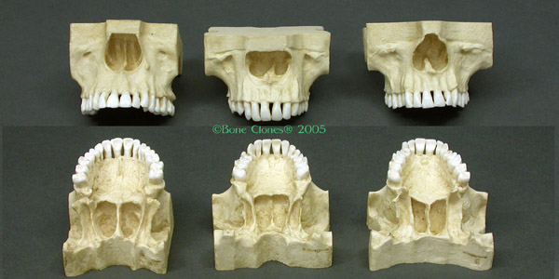
Based upon both criteria, label the following maxilla according to race:
#1 #2 #3

Slide 22
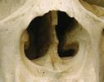
Many of these features are quite subtle, and require detailed examination of the skull. A couple of features, however, are more easily seen. For example, in people of African ancestry, the nasal opening is more flared.

Slide 23
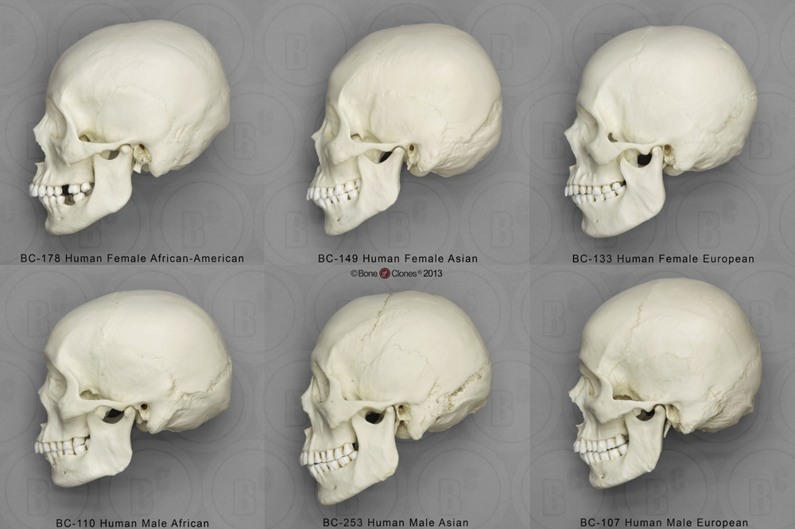
Another example is that of the zygomatic arch (or cheek bone), which is angled more forward in people of Asian ancestry, gives the person a slightly more flattened face.

Slide 24
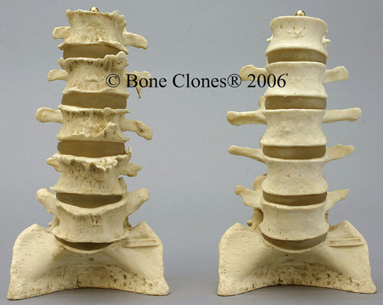
AGE
One way we could tell is by looking at the condition of the bones themselves, with the older bones being more likely to be arthritic. Examine the bones below, and label which is arthritic (and therefore older), and which is the younger:
#1 #2

Slide 25
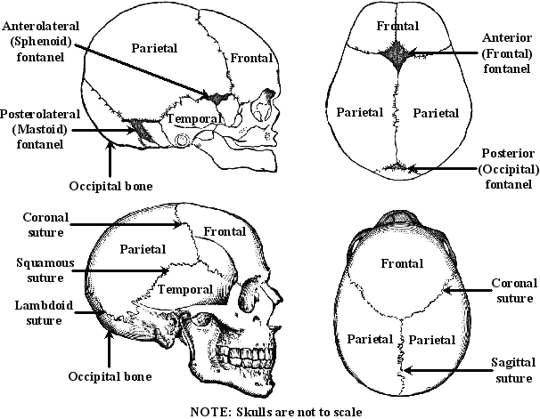
Another way to determine age is by looking at the development of the sutures. The adult skull has no remaining frontal suture in the middle of the Frontal bone. Remember, also, that all the sutures ultimately become more filled-in ("closed") as we age.

Slide 26
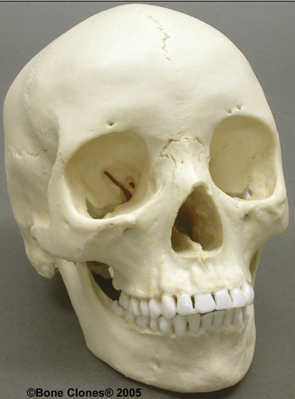
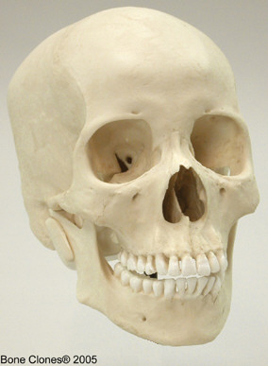
Compare the two skulls below to determine which skull is from an adult, and which is from an adolescent:
#1 #2

Slide 27
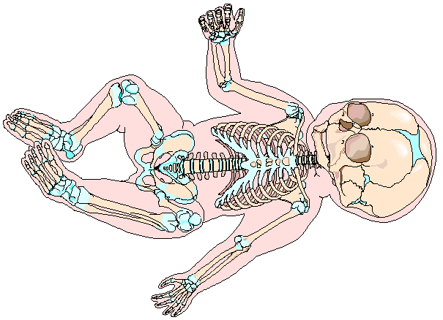
Can you see the fontanels in the image below? Note how many places in the infant skeleton are still made of cartilage, which appears blue. The indicates how much of the skeleton is still developing.

Slide 28
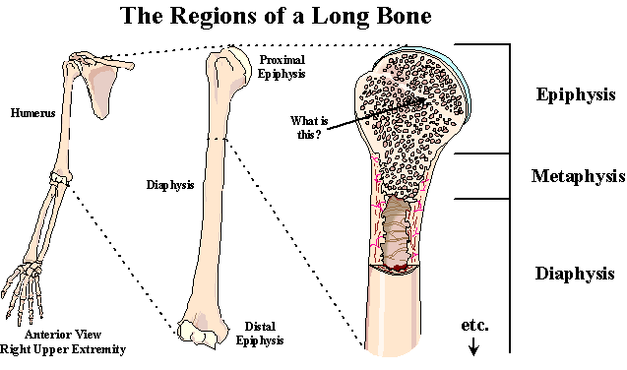
Another way to determine age is to look at the epiphysis (end) of a long bone (the shape of which should be self-explanatory).

Slide 29
An x-ray image (radiograph) of a child will reveal a dark area where the growth plates are still made of cartilage (more x-rays can pass through cartilage, which is less dense, thus making a dark area); these areas are the epiphyseal plates. An x-ray radiograph of an adult will reveal a white area where the growth plates have been turned into bone (fewer x-rays can pass through bone, which is more dense, thus making a white line); these areas are the epiphyseal lines.

Slide 30
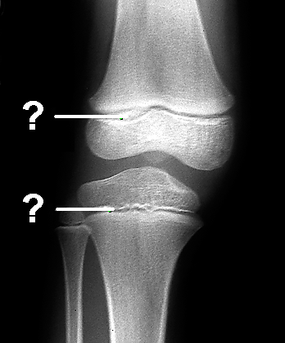
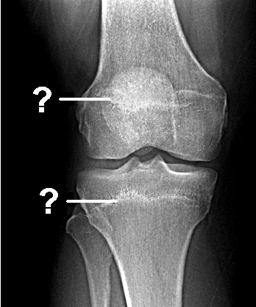
Examine the radiographs below, and determine whether they are from adults or children:
#1 #2

Slide 31
HEIGHT
Often a skeleton is incomplete. Despite this, it is still possible to calculate, with a certain amount of accuracy, the height of a skeleton.
Apart from height, average weight can be calculated based on not only the general size of the bones, but also by evidence of the weight borne by the bones. These weight calculations, however, are too complex to demonstrate without detailed examination of the bones, which obviously cannot be done on a paper worksheet.

Slide 32
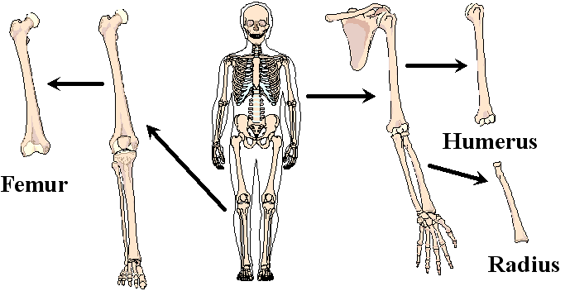
Any of the major bones of the arm or leg can be used to determine height. The major bones of the arm are the humerus, ulna, and radius. The major bones of the leg are the femur, tibia, and fibula. Given that not everyone's arm to leg ratio is exact, height is usually estimated by using more than one bone, if possible. The calculations we will be looking at will be of the femur, humerus, and radius.

Slide 33
In order to calculate the height, in inches, follow the formulas below for each of the bones. Be sure to indicate height not only in the total number of inches, but in terms of feet and inches (i.e., a person who is 62 inches is also described as being 5 feet, 2 inches tall, or 5' 2"). NOTE: The calculations, of course, are different when measurements are in centimeters.
Bone | Formula for calculating Body Height (in inches)
 | Female | Male
Femur | Height equals (length of femur x 1.94) + 28.7 | Height equals (length of femur x 1.88) + 32
Humerus | Height equals (length of humerus x 2.8) + 28.1 | Height equals (length of humerus x 2.9) + 27.8
Radius | Height equals (length of radius x 3.3) + 32 | Height equals (length of radius x 3.3) + 34

Slide 34
For the rest of the world that measures in metrics, here are the formulas for centimeters.
Bone | Formula for calculating Body Height (in cm) . . . EVERYONE!
 | Female | Male
Femur | Height equals (length of femur x 1.94) + 72.9 | Height equals (length of femur x 1.88) + 81.3
Humerus | Height equals (length of humerus x 2.8) + 71.4 | Height equals (length of humerus x 2.9) + 70.6
Radius | Height equals (length of radius x 3.3) + 81.3 | Height equals (length of radius x 3.3) + 86.4

