Slide 1
The Milky Way Galaxy
Chapter 15

Slide 2
The Milky Way
Almost everything we see in the night sky belongs to the Milky Way
From the outside, our Milky Way might look very much like our cosmic neighbor, the Andromeda galaxy
We see most of the Milky Way as a faint band of light across the sky

Slide 3
The Structure of the Milky Way (1)
Disk
Nuclear Bulge
Sun
Halo
Globular Clusters

Slide 4
The Structure of the Milky Way (2)
Galactic Plane
Galactic Center
The structure is hard to determine because:
1) We are inside
2) Distance measurements are difficult
3) Our view towards the center is obscured by gas and dust

Slide 5
First Studies of the Galaxy
First attempt to unveil the structure of our Galaxy by William Herschel (1785), based on optical observations
The shape of the Milky Way was believed to resemble a grindstone, with the sun close to the center

Slide 6
Strategies to Explore the Structure of Our Milky Way
I. Select bright objects that you can see throughout the Milky Way and trace their directions and distances
II. Observe objects at wavelengths other than visible (to circumvent the problem of optical obscuration), and catalogue their directions and distances
III. Trace the orbital velocities of objects in different directions relative to our position

Slide 7
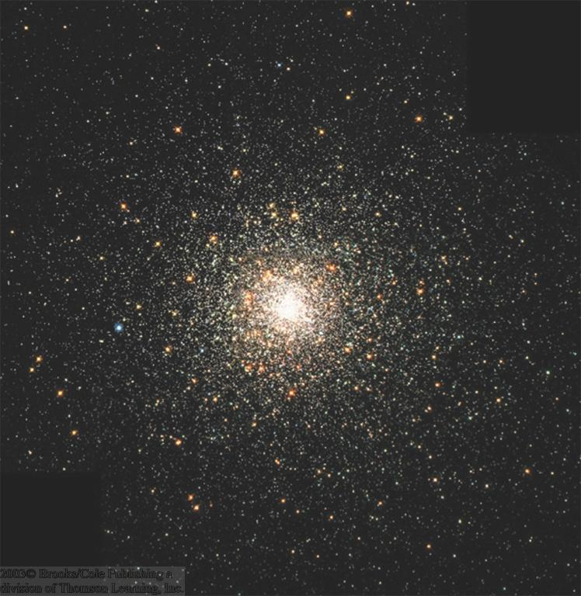
Exploring the Galaxy Using Clusters of Stars
Two types of star clusters:
Open clusters h and χ Persei
1) Open clusters: young clusters of recently formed stars; within the disk of the Galaxy
2) Globular clusters: old, centrally concentrated clusters of stars; mostly in a halo around the Galaxy
Globular Cluster M 19

Slide 8
Globular Clusters
Dense clusters of 50,000 – 1 million stars
Old (~ 11 billion years), lower-main-sequence stars
Approx. 200 globular clusters in our Milky Way
Globular Cluster M80

Slide 9
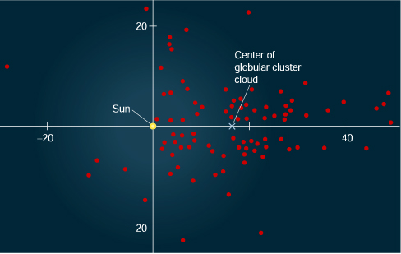
Locating the Center of the Milky Way
Distribution of globular clusters is not centered on the sun…
…but on a location which is heavily obscured from direct (visual) observation

Slide 10
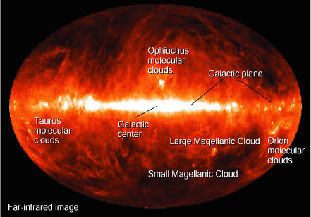
Infrared View of the Milky Way
Near infrared image
Interstellar dust (absorbing optical light) emits mostly infrared
Galactic Plane
Nuclear bulge
Infrared emission is not strongly absorbed and provides a clear view throughout the Milky Way

Slide 11
A View of Galaxies Similar to Our Milky Way
We also see gas and dust absorbing light in other galaxies…
…as dark dust lanes when we see a galaxy edge-on
Sombrero Galaxy
…and as dark clouds in the spiral arms when we see a galaxy face-on
NGC 2997

Slide 12
Exploring the Milky Way with Massive Stars and Open Clusters
O and B stars are the most massive, most luminous stars (unfortunately, also the shortest-lived ones)
=> Look for very young clusters or associations containing O and B stars: O/B Associations!

Slide 13
Massive Stars and Open Clusters
Problem: Many stars in the field of the O/B association do not belong to the association (foreground and background stars)
→ Identify members through their similar motion on the sky.
Members of the association have been formed together and move in the same direction

Slide 14
Orbital Motion in the Milky Way (1)
Disk stars:
Nearly circular orbits in the disk of the Galaxy
Halo stars:
Highly elliptical orbits; randomly oriented

Slide 15
Orbital Motion in the Milky Way (2)
Differential Rotation
Sun orbits around Galactic center with 220 km/s
1 orbit takes approx. 240 million years
Stars closer to the galactic center orbit faster
Stars farther out orbit more slowly

Slide 16
Finding Mass from Orbital Velocity
The more mass there is inside the orbit, the faster the sun has to orbit around the Galactic center
Combined mass:
M = 4 billion M_{sun}
M = 11 billion M_{sun}
M = 25 billion M_{sun}
M = 100 billion M_{sun}
M = 400 billion M_{sun}

Slide 17
The Mass of the Milky Way
If all mass were concentrated in the center, the rotation curve would follow a modified version of Kepler’s 3rd law
rotation curve = orbital velocity as function of radius

Slide 18
The Mass of the Milky Way (2)
Total mass in the disk of the Milky Way:
Approx. 200 billion solar masses
Additional mass in an extended halo:
Total: Approx. 1 trillion solar masses
Most of the mass is not emitting any radiation:
Dark Matter!

Slide 19
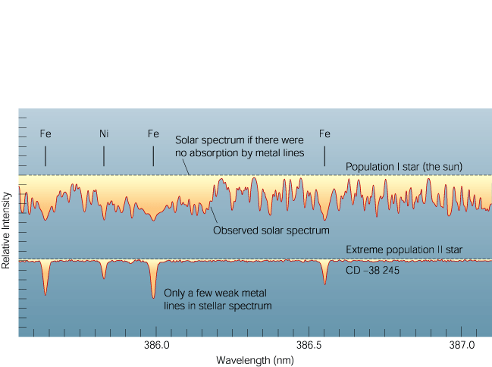
Metals in Stars
Absorption lines almost exclusively from hydrogen: Population II
Many absorption lines also from heavier elements (metals): Population I
At the time of formation, the gases forming the Milky Way consisted exclusively of hydrogen and helium. Heavier elements (“metals”) were later only produced in stars.
=> Young stars contain more metals than older stars

Slide 20
Stellar Populations
Population I: Young stars: metal rich; located in spiral arms and disk
Population II: Old stars: metal poor; located in the halo (globular clusters) and nuclear bulge

Slide 21
The Abundance of Elements in the Universe
All elements heavier than He are very rare.
Logarithmic Scale
Linear Scale

Slide 22
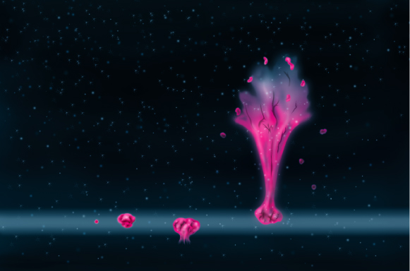
Galactic Fountains
Multiple supernovae in regions of recent star formation produce bubbles of very hot gas
This hot gas can break out of the galactic disk and produce a galactic fountain
As the gas cools, it falls back to the disk, spreading heavy elements throughout the galaxy

Slide 23
History of the Milky Way
The traditional theory:
Quasi-spherical gas cloud fragments into smaller pieces, forming the first, metal-poor stars (pop. II);
Rotating cloud collapses into a disk-like structure
Later populations of stars (pop. I) are restricted to the disk of the Galaxy

Slide 24
Changes to the Traditional Theory
Ages of stellar populations may pose a problem to the traditional theory of the history of the Milky Way
Possible solution: Later accumulation of gas, possibly due to mergers with smaller galaxies
Recently discovered ring of stars around the Milky Way may be the remnant of such a merger

Slide 25
O and B Associations
O and B Associations
Perseus arm
Orion-Cygnus arm
Sun
Sagittarius arm
O and B Associations trace out 3 spiral arms near the Sun
Distances to O and B associations determined using cepheid variables

Slide 26
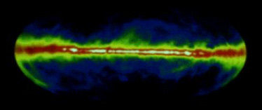
Radio View of the Milky Way
Interstellar dust does not absorb radio waves
We can observe any direction throughout the Milky Way at radio waves
Radio map at a wavelength of 21 cm, tracing neutral hydrogen

Slide 27
Radio Observations (2)
21-cm radio observations reveal the distribution of neutral hydrogen throughout the galaxy
Distances to hydrogen clouds determined through radial-velocity measurements (Doppler effect!)
Sun
Galactic Center
Neutral hydrogen concentrated in spiral arms

Slide 28
Tracing Molecular Clouds
Radio emission of the CO molecule can be used to trace the distribution of molecular clouds
In some directions, many molecular clouds overlap
Clouds can be disentangled using velocity information
Molecular Clouds are concentrated along spiral arms

Slide 29
Structure of the Milky Way Revealed
Distribution of dust
Sun
Distribution of stars and neutral hydrogen
Bar
Ring

Slide 30
Star Formation in Spiral Arms
Shock waves from supernovae, ionization fronts initiated by O and B stars, and the shock fronts forming spiral arms trigger star formation
Spiral arms are stationary shock waves, initiating star formation

Slide 31
Star Formation in Spiral Arms (2)
Spiral arms are basically stationary shock waves
Stars and gas clouds orbit around the Galactic center and cross spiral arms
Shocks initiate star formation
Star formation self-sustaining through O and B ionization fronts and supernova shock waves

Slide 32
The Nature of Spiral Arms
Spiral arms appear bright (newly formed, massive stars!) against the dark sky background…
but dark (gas and dust in dense, star-forming clouds) against the bright background of the large galaxy
Chance coincidence of small spiral galaxy in front of a large background galaxy

Slide 33
Grand-Design Spiral Galaxies
Flocculent (woolly) galaxies also have spiral patterns, but no dominant pair of spiral arms
Grand-Design Spirals have two dominant spiral arms
M 100
NGC 300

Slide 34
Self-Sustained Star Formation in Spiral Arms
Star forming regions get elongated due to differential rotation
Star formation is self-sustaining due to ionization fronts and supernova shocks

Slide 35
The Whirlpool Galaxy
Grand-design galaxy M 51 (Whirlpool Galaxy)
Self-sustaining star forming regions along spiral arm patterns are clearly visible

Slide 36
The Galactic Center (1)
Our view (in visible light) towards the galactic center (GC) is heavily obscured by gas and dust
Extinction by 30 magnitudes
⬄ Only 1 out of 10¹² optical photons makes its way from the GC towards Earth!
Galactic center
Wide-angle optical view of the GC region

Slide 37
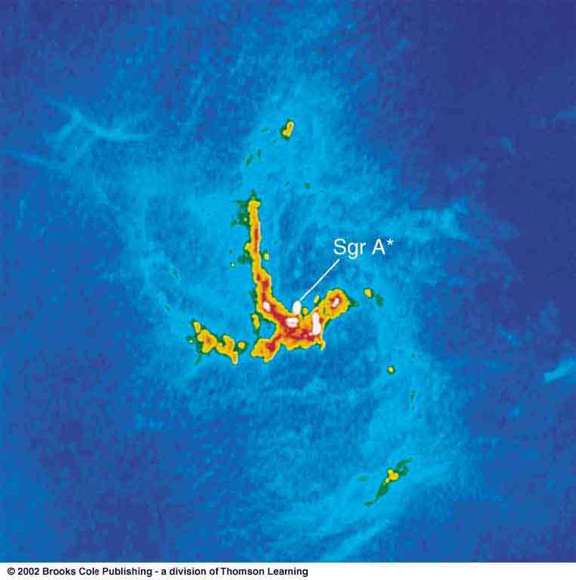
Radio View of the Galactic Center
Many supernova remnants; shells and filaments
Arc
Sgr A
Sgr A
Sgr A*: The center of our galaxy
The galactic center contains a supermassive black hole of approx. 2.6 million solar masses

Slide 38
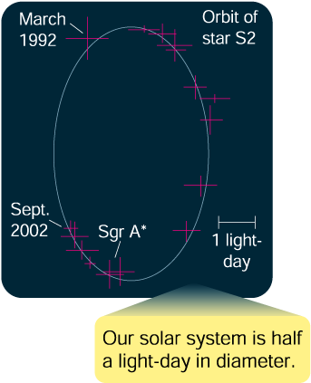
A Black Hole at the Center of Our Galaxy
By following the orbits of individual stars near the center of the Milky Way, the mass of the central black hole could be determined to ~ 2.6 million solar masses

Slide 39
X-ray View of the Galactic Center
Galactic center region contains many black-hole and neutron-star X-ray binaries
Supermassive black hole in the galactic center is unusually faint in X-rays, compared to those in other galaxies
Chandra X-ray image of Sgr A*

Slide 40
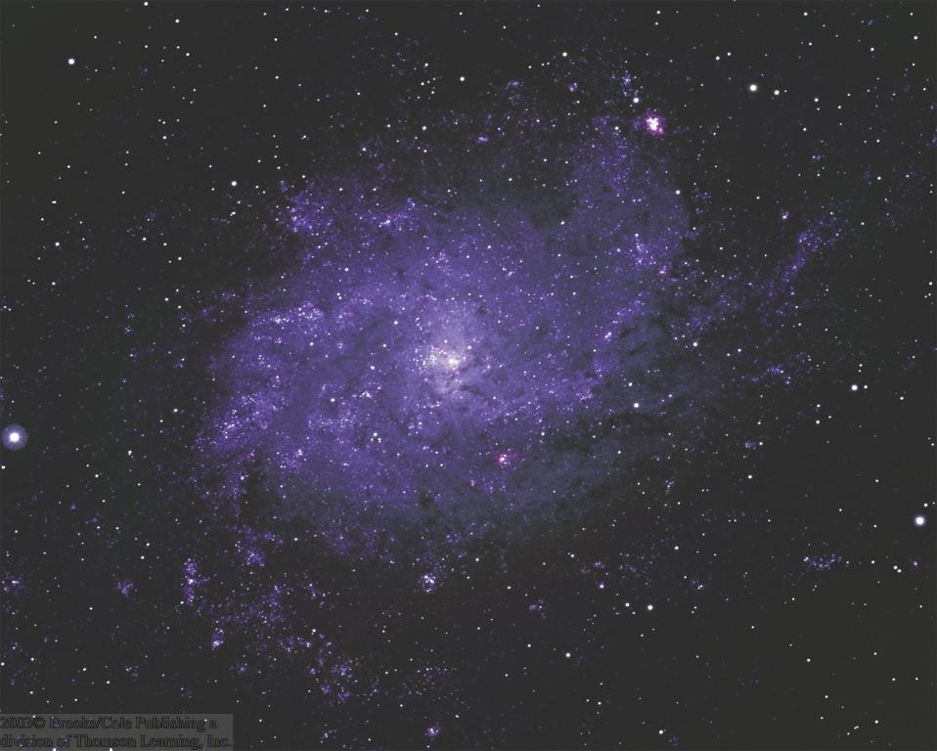
Galaxies
Star systems like our Milky Way
Contain a few thousand to tens of billions of stars.
Large variety of shapes and sizes

Slide 41
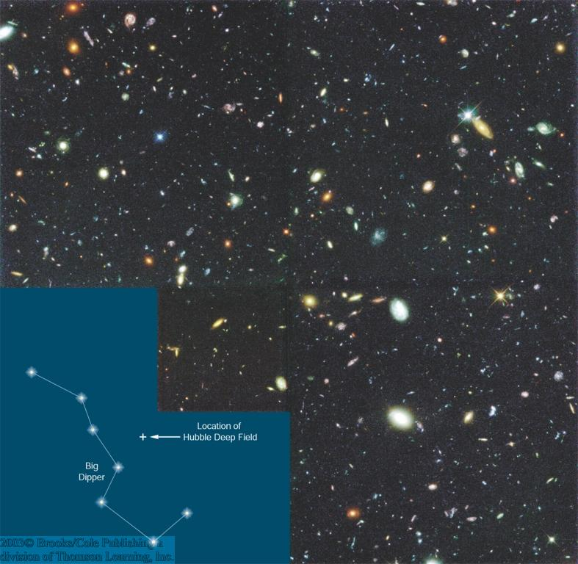
Galaxy Diversity
Even seemingly empty regions of the sky contain thousands of very faint, very distant galaxies
Large variety of galaxy morphologies:
Spirals
Ellipticals
Irregular
(some interacting)
The Hubble Deep Field:
10-day exposure on an apparently empty field in the sky

Slide 42
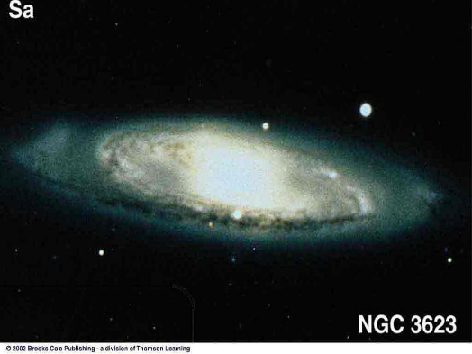
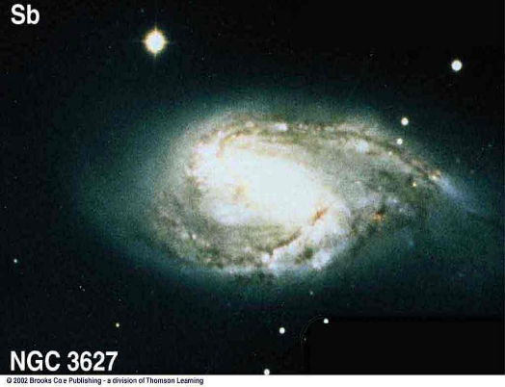
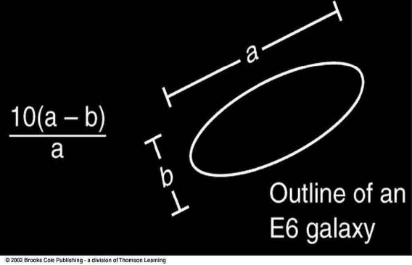
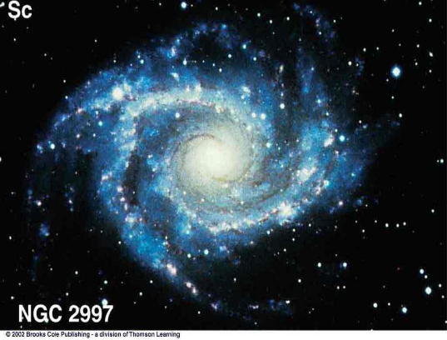
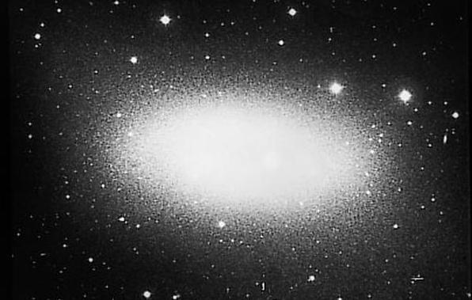
Galaxy Classification
E0, …, E7
Sa
Large nucleus; tightly wound arms
E0 = Spherical
E1
Sb
Sc
Small nucleus; loosely wound arms
E7 = Highly elliptical
E6

Slide 43
Gas and Dust in Galaxies
Spirals are rich in gas and dust
Ellipticals are almost devoid of gas and dust
Galaxies with disk and bulge, but no dust are termed S0

Slide 44
Barred Spirals
Some spirals show a pronounced bar structure in the center
They are termed barred spiral galaxies
Sequence:
SBa, …, SBc,
analogous to regular spirals

Slide 45
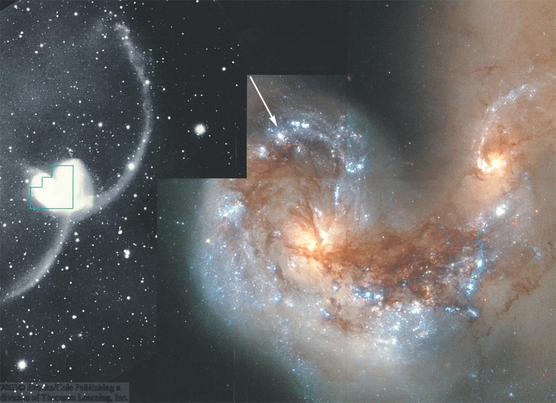
Irregular Galaxies
Often: result of galaxy collisions / mergers
Often: Very active star formation (“Starburst galaxies”)
The Cocoon Galaxy
NGC 4038/4039
Some: Small (“dwarf galaxies”) satellites of larger galaxies
(e.g., Magellanic Clouds)
Large Magellanic Cloud

Slide 46
Distance Measurements to Other Galaxies (1)
Cepheid Method: Using Period – Luminosity relation for classical Cepheids:
Measure Cepheid’s Period → Find its luminosity → Compare to apparent magnitude → Find its distance
b) Type Ia Supernovae (collapse of an accreting white dwarf in a binary system):
Type Ia Supernovae have well known standard luminosities → Compare to apparent magnitudes → Find its distances
Both are “Standard-candle” methods:
Know absolute magnitude (luminosity) → compare to apparent magnitude → find distance.

Slide 47
Cepheid Distance Measurement
Repeated brightness measurements of a Cepheid allow the determination of the period and thus the absolute magnitude.
→ Distance

Slide 48
The Most Distant Galaxies
At very large distances, only the general characteristics of galaxies can be used to estimate their luminosities → distances.
Cluster of galaxies at ~ 4 to 6 billion light years

Slide 49
Distance Measurements to Other Galaxies (2): The Hubble Law
E. Hubble (1913):
Distant galaxies are moving away from our Milky Way, with a recession velocity, v_{r}, proportional to their distance d:
v_{r} = H₀*d
H₀ ≈ 70 km/s/Mpc is the Hubble constant
Measure v_{r} through the Doppler effect → infer the distance

Slide 50
The Extragalactic Distance Scale
Many galaxies are typically millions or billions of parsecs from our galaxy.
Typical distance units:
Mpc = Megaparsec = 1 million parsec
Gpc = Gigaparsec = 1 billion parsec
Distances of Mpc or even Gpc ⬄ The light we see left the galaxy millions or billions of years ago!!
“Look-back times” of millions or billions of years

Slide 51
Galaxy Sizes and Luminosities
Vastly different sizes and luminosities:
From small, low-luminosity irregular galaxies (much smaller and less luminous than the Milky Way) to giant ellipticals and large spirals, a few times the Milky Way’s size and luminosity

Slide 52
Rotation Curves of Galaxies
From blue / red shift of spectral lines across the galaxy
→ infer rotational velocity
Plot of rotational velocity vs. distance from the center of the galaxy: Rotation Curve
Observe frequency of spectral lines across a galaxy.

Slide 53
Determining the Masses of Galaxies
Based on rotation curves, use Kepler’s 3rd law to infer
masses of galaxies

Slide 54
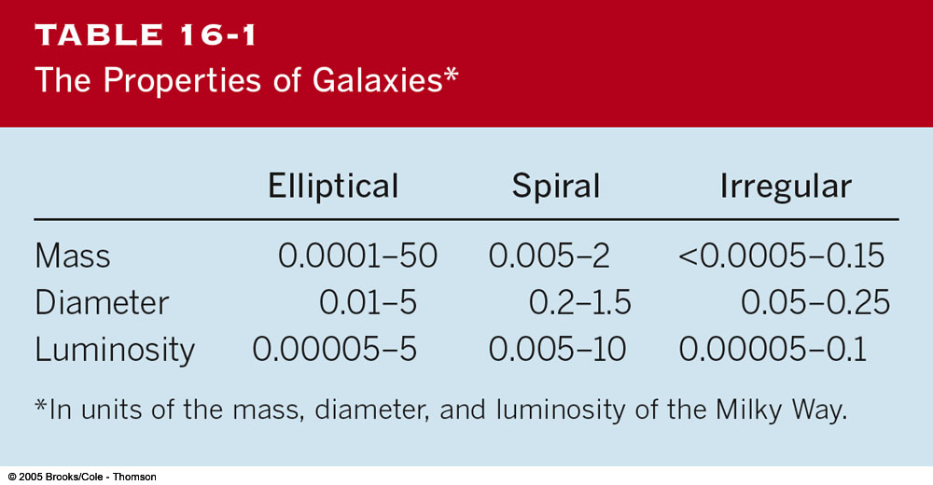
Masses and Other Properties of Galaxies

Slide 55
Supermassive Black Holes
From the measurement of stellar velocities near the center of a galaxy:
Infer mass in the very center → central black holes!
Several million, up to more than a billion solar masses!
→ Supermassive black holes

Slide 56
Dark Matter
Adding “visible” mass in:
stars,
interstellar gas,
dust,
…etc., we find that most of the mass is “invisible”!
The nature of this “dark matter” is not understood at this time.
Some ideas: brown dwarfs, small black holes, exotic elementary particles.

Slide 57
Clusters of Galaxies
Galaxies generally do not exist in isolation, but form larger clusters of galaxies.
Rich clusters:
1,000 or more galaxies, diameter of ~ 3 Mpc, condensed around a large, central galaxy
Poor clusters:
Less than 1,000 galaxies (often just a few), diameter of a few Mpc, generally not condensed towards the center

Slide 58
Hot Gas in Clusters of Galaxies
Space between galaxies is not empty, but filled with hot gas (observable in X-rays)
That this gas remains gravitationally bound provides further evidence for dark matter.
Visible light
X-rays
Coma Cluster of Galaxies

Slide 59
Our Galaxy Cluster: The Local Group
Milky Way
Andromeda galaxy
Small Magellanic Cloud
Large Magellanic Cloud

Slide 60
Neighboring Galaxies
Some galaxies of our local group are difficult to observe because they are located behind the center of our Milky Way, from our view point.
Spiral Galaxy Dwingeloo 1

Slide 61
Interacting Galaxies
Cartwheel Galaxy
Particularly in rich clusters, galaxies can collide and interact.
Galaxy collisions can produce
ring galaxies and
tidal tails.
NGC 4038/4039
Often triggering active star formation: starburst galaxies

Slide 62
Tidal Tails
Example for galaxy interaction with tidal tails:
The Mice
Computer simulations produce similar structures.

Slide 63
Simulations of Galaxy Interactions
Numerical simulations of galaxy interactions have been very successful in reproducing tidal interactions like bridges, tidal tails, and rings.

Slide 64
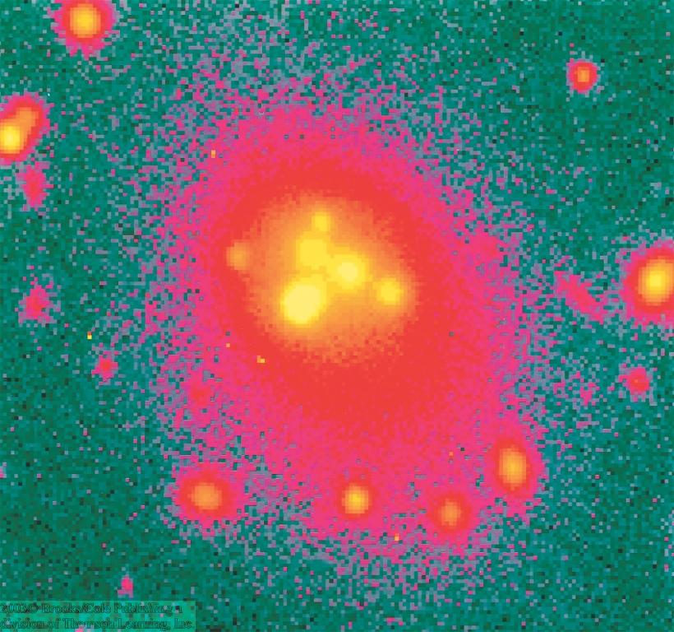
Mergers of Galaxies
Radio image of M 64: Central regions rotating backward!
NGC 7252: Probably result of merger of two galaxies, ~ a billion years ago:
Small galaxy remnant in the center is rotating backward!
Multiple nuclei in giant elliptical galaxies

Slide 65
Galactic Cannibalism
NGC 5194
Collisions of large with small galaxies often result in complete disruption of the smaller galaxy.
Small galaxy is “swallowed” by the larger one.
This process is called “galactic cannibalism”

Slide 66
Starburst Galaxies
Starburst galaxies are often very rich in gas and dust; bright in infrared:
ultraluminous infrared galaxies
M 82
Cocoon Galaxy

Slide 67
Large Scale Structure
Superclusters = clusters of clusters of galaxies
Superclusters appear aligned along walls and filaments.
Vast regions of space are completely empty:
“voids”

Slide 68
The Farthest Galaxies
The most distant galaxies visible by HST are seen at a time when the universe was only ~ 1 billion years old.

