Slide 1
Meteorites, Asteroids, and Comets
Unit 4

Slide 2
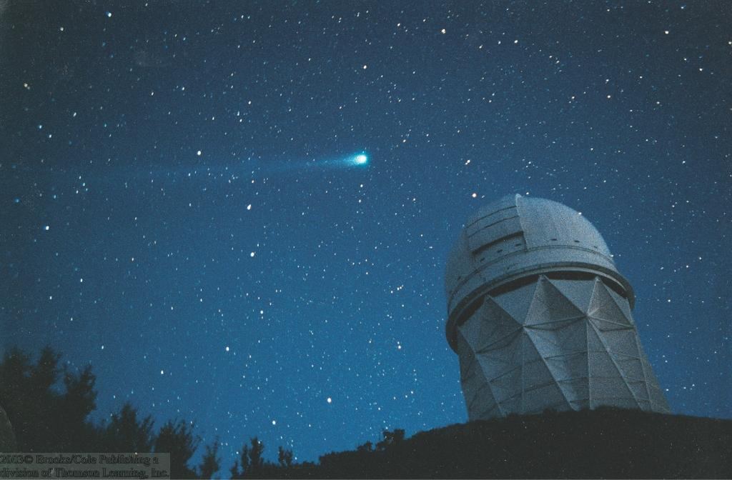
Comets of History
Throughout history, comets have been considered as portents of doom, even very recently:
Appearances of comet Kohoutek (1973), Halley (1986), and Hale-Bopp (1997) caused great concern among superstitious.
Comet Hyakutake in 1996

Slide 3
Meteorites
Distinguish between:
Meteoroid = small body in space
Meteor = meteoroid colliding with Earth and producing a visible light trace in the sky
Meteorite = meteor that survives the plunge through the atmosphere to strike the ground...
Sizes from microscopic dust to a few centimeters.
About 2 meteorites large enough to produce visible impacts strike the Earth every day.
Statistically, one meteorite is expected to strike a building somewhere on Earth every 16 months.
Typically impact onto the atmosphere with 10 – 30 km/s (≈ 30 times faster than a rifle bullet).
.

Slide 4
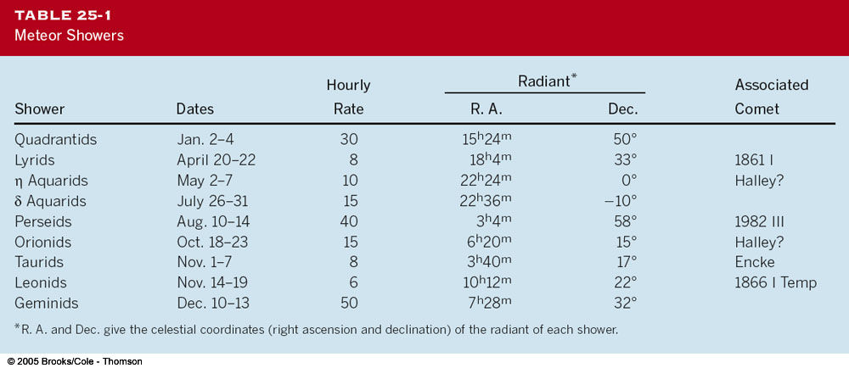
Meteor Showers
Most meteors appear in showers, peaking periodically at specific dates of the year.

Slide 5
Radiants of Meteor Showers
Tracing the tracks of meteors in a shower backwards, they appear to come from a common origin, the radiant.
← Common direction of motion through space.

Slide 6
Meteoroid Orbits
Meteoroids contributing to a meteor shower are debris particles, orbiting in the path of a comet.
Spread out all along the orbit of the comet.
Comet may still exist or have been destroyed.
Only a few sporadic meteors are not associated with comet orbits.

Slide 7
Meteorite Impacts on Earth
Over 150 impact craters found on Earth.
Famous example: Barringer Crater near Flagstaff, AZ:
Formed ~ 50,000 years ago by a meteorite of ~ 80 – 100 m diameter

Slide 8
Impact Craters on Earth
Barringer Crater: ~ 1.2 km diameter; 200 m deep
Much larger impact features exist on Earth:
Impact of a large body formed a crater ~ 180 – 300 km in diameter in the Yucatán peninsula, ~ 65 million years ago.
Drastic influence on climate on Earth; possibly responsible for extinction of dinosaurs.

Slide 9
Finding Meteorites
Most meteorites are small and do not produce significant craters.
Good place to find meteorites: Antarctica!
Distinguish between:
Falls = meteorites which have been observed to fall (fall time known).
Finds = meteorites with unknown fall time.

Slide 10
Analysis of Meteorites
3 broad categories:
Iron meteorites
Stony meteorites
Stony-Iron meteorites

Slide 11
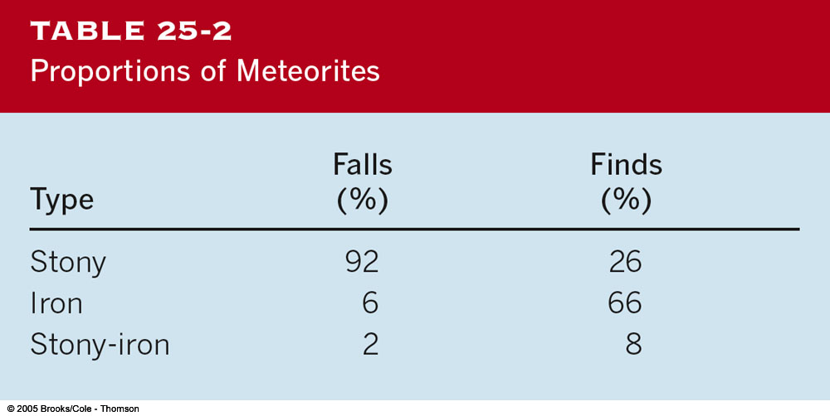
What Does a “Meteorite” Look Like?
Selection bias:
Iron meteorites are easy to recognize as meteorites (heavy, dense lumps of iron-nickel steel) – thus, more likely to be found and collected.

Slide 12
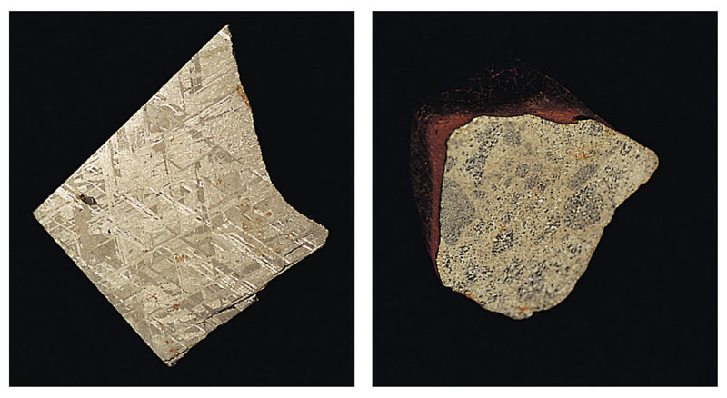
Meteor: The bright tail of hot debris from the rock
Meteorite: A rock from space that reaches Earth’s surface
Notes:
Really useless terminology: “Meteroid” - the rock before it hits the Earth’s surface.

Slide 13
Peekskill, NY:
October 9, 1992
Notes:
A movie of this meteorite flying through the Earth’s atmosphere is available for public use at
http://impacts.arc.nasa.gov/gallery/comet2.mpg Other meteors/meteorite events available on
The web include the March 26, 2003 Park Forest IL event; August 10, 1972 Grand Tetons, WY (a BIG one skipping off the atmosphere.)

Slide 14
Pieces of Asteroids:Meteorite Types
Primitive: Unchanged in composition since they first formed 4.6 billion years ago.
Processed: Younger, have experienced processes like volcanism or differentiation.

Slide 15
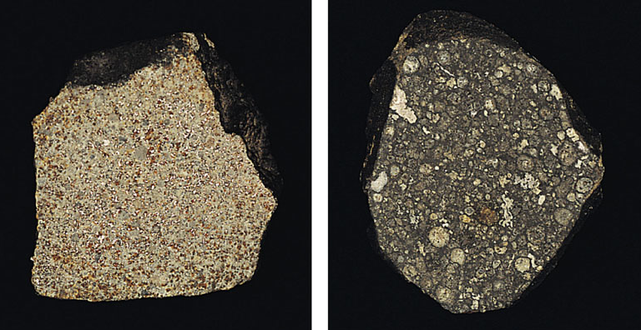
Primitive Meteorites: simple, all ingredients mixed together
Notes:
Simple rocks and metal, occasionally carbon compounds and water.
Shiny bits are metal flakes, first to condense.
White features are solidified dropletsof material that splashed out during impacts during accretion

Slide 16
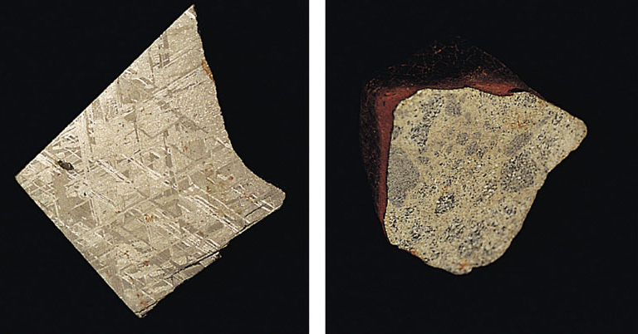
Processed Meteorites: shattered fragments of larger objects
Iron from a core
Volcanic rock from a crust or mantle

Slide 17
What do we learn from meteorites?
primitive meteorites tell us when solar system formation began.
Processed meteorites tell us what asteroids are like on the inside.
Processed meteorites provide direct proof that differentiation and volcanism happened on asteroids.

Slide 18
Meteorites from Moon and Mars
A few meteorites arrive from the Moon and Mars
Composition differs from the asteroid fragments.
A cheap (but slow) way to acquire moon rocks and Mars rocks.
One Mars meteorite generated a stir when scientists claimed evidence for microscopic life in it.

Slide 19
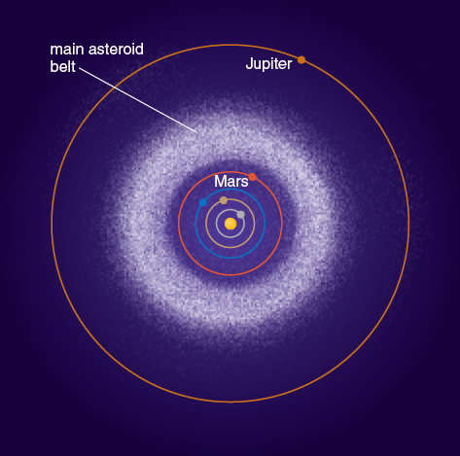
What have we learned?
• Why is there an asteroid belt?
Orbital resonances with Jupiter disrupted the orbits of planetesimals, preventing them from accreting into a planet. Those that were not ejected from this region make up the asteroid belt today. Most asteroids in other regions of the inner solar system accreted into one of the planets.
• How are meteorites related to asteroids?
Most meteorites are pieces of asteroids. Primitive meteorites are essentially unchanged since the birth of the solar system. Processed meteorites are fragments of larger asteroids that underwent differentiation.

Slide 20
The Allende Meteorite
Carbonaceous chondrite, fell in 1969 near Pueblito de Allende, Mexico
Showered an area about 50 km x 10 km with over 4 tons of fragments.
Fragments containing calcium-aluminum-rich inclusions (CAIs)
Extremely temperature-resistant materials.
Allende meteorite is a very old sample of solar-nebula material!

Slide 21
The Origins of Meteorites
Probably formed in the solar nebula, ~ 4.6 billion years ago.
Almost certainly not from comets (in contrast to meteors in meteor showers!).
Probably fragments of stony-iron planetesimals
Some melted by heat produced by ²⁶Al decay (half-life ~ 715,000 yr).
²⁶Al possibly provided by a nearby supernova, just a few 100,000 years before formation of the solar system (triggering formation of our sun?)

Slide 22
The Origins of Meteorites (2)
Planetesimals cool and differentiate
Collisions eject material from different depths with different compositions and temperatures.
Meteorites can not have been broken up from planetesimals very long ago
→ so remains of planetesimals should still exist.
→ Asteroids

Slide 23
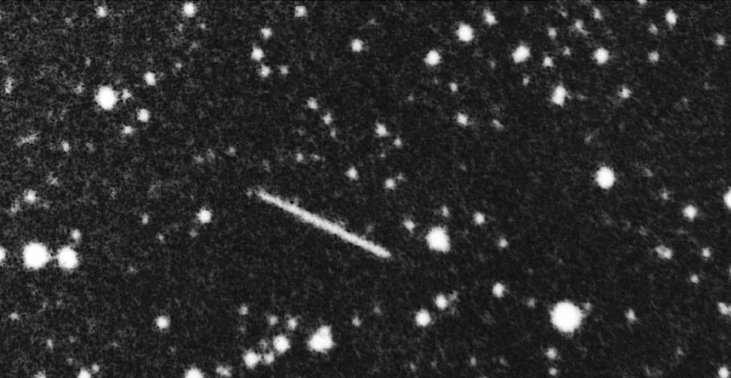
Asteroid Facts
Asteroids are rocky leftovers of planet formation.
Largest is Ceres, diameter ~1,000 km
150,000 in catalogs, and probably over a million with diameter >1 km.
Small asteroids are more common than large asteroids.
All the asteroids in the solar system wouldn’t add up to even a small terrestrial planet.

Slide 24
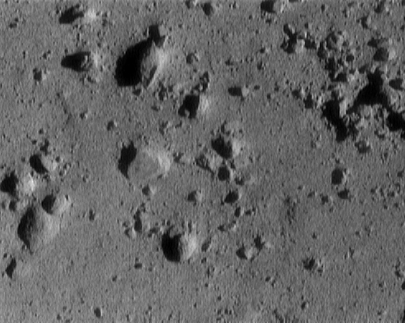
Asteroids are cratered and not round
Notes:
Thought question: were these pictures taken from Earth?
One of these has a satellite (Ida is orbitted by Dactyl, lower left)

Slide 25
Asteroids
Last remains of planetesimals that built the planets 4.6 billion years ago!

Slide 26
The Asteroid Belt
Small, irregular objects, mostly in the apparent gap between the orbits of Mars and Jupiter.
Thousands of asteroids with accurately determined orbits known today.
Sizes and shapes of the largest asteroids, compared to the moon

Slide 27
Kirkwood’s Gaps
The asteroid orbits are not evenly distributed throughout the asteroid belt between Mars and Jupiter.
There are several gaps where no asteroids are found:
Kirkwood’s gaps (purple bars below)
These correspond to resonances of the orbits with the orbit of Jupiter.
Example:
2:3 resonance

Slide 28
Non-Belt Asteroids
Not all asteroids orbit within the asteroid belt.
Apollo-Amor Objects:
Trojans: Sharing stable orbits along the orbit of Jupiter:
Asteroids with elliptical orbits, reaching into the inner solar system.
Trapped in the Lagrangian points of Jupiter.
Some potentially colliding with Mars or Earth.

Slide 29
Colors of Asteroids
M-type: Brighter, less reddish asteroids, probably made out of metal rich materials; probably iron cores of fragmented asteroids
S-type: Brighter, redder asteroids, probably made out of rocky materials; very common in the inner asteroid belt
C-type: Dark asteroids, probably made out of carbon-rich materials (carbonaceous chondrites); common in the outer asteroid belt
“Colors” to be interpreted as albedo (reflectivity) at different wavelengths.

Slide 30
The Origin of Asteroids
Distribution: S-type asteroids in the outer asteroid belt; C-type asteroids in inner asteroid belt → may reflect temperatures during the formation process.
However, more complex features found:
Vesta shows evidence for impact crater and lava flows.
Images of the Asteroid Vesta show a complex surface, including a large impact crater.
Heat for existence of lava flows probably from radioactive decay of ²⁶Al.
Meteorite probably fragmented from Vesta

Slide 31
Rocky planetesimals survived in the asteroid belt between Mars and Jupiter because they did not accrete into a planet.
Jupiter’s gravity, stirs up the asteroid orbits and prevents their planet formation.

