Slide 1
Our Solar System
(An Introductory Tour)

Slide 2
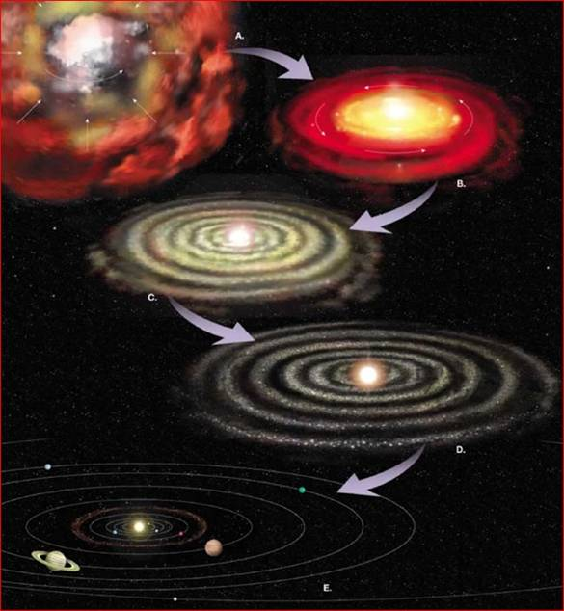
Solar System Formation
Thanks
to
Mary
Oshana

Slide 3
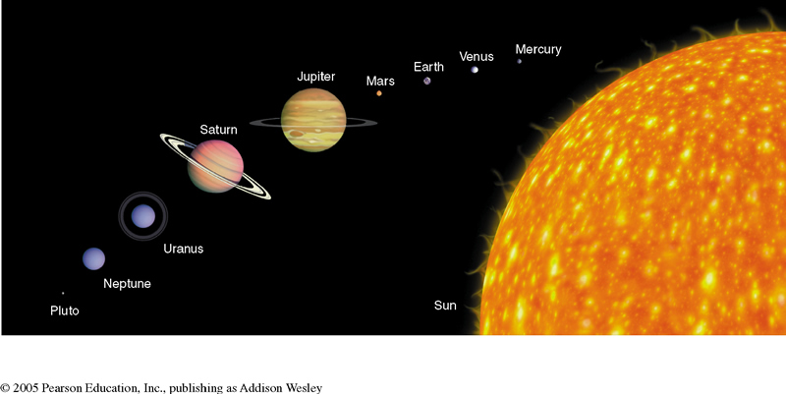

Slide 4
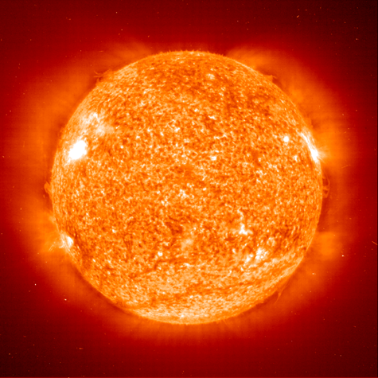
Our Favorite Star

Slide 5
What are some of the various Hypothesis for the formation of our solar system

Slide 6
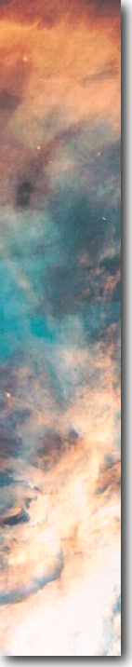
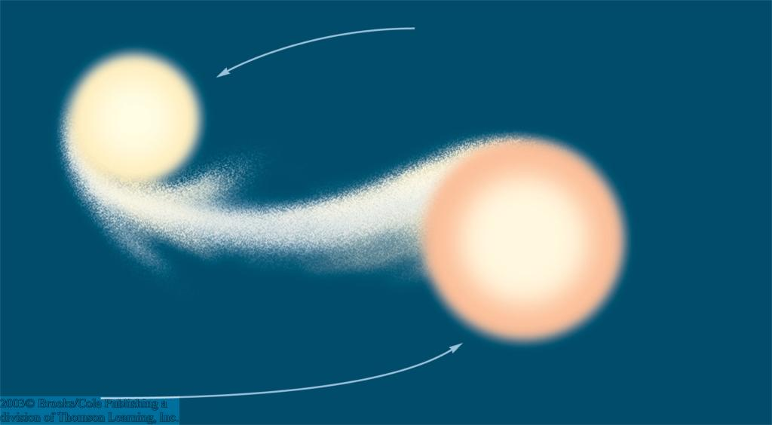
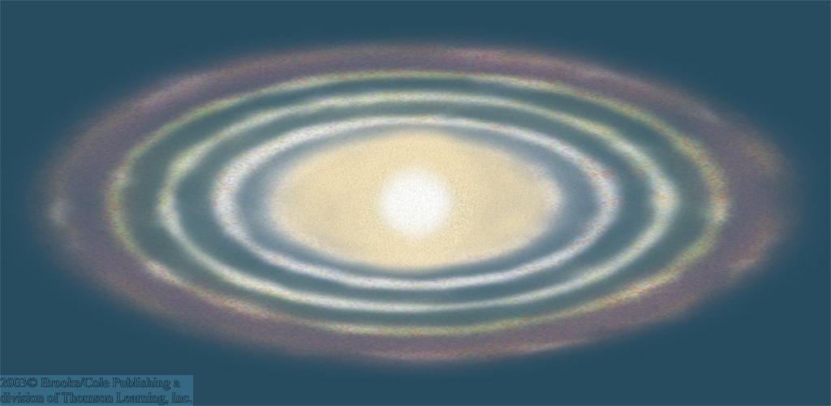
Early Hypotheses
catastrophic hypotheses, e.g., passing star hypothesis:
Star passing the sun closely tore material out of the sun, from which planets could form (no longer considered)
Catastrophic hypotheses predict: Only few stars should have planets!
evolutionary hypotheses, e.g., Laplace’s nebular hypothesis:
Rings of material separate from the spinning cloud, carrying away angular momentum of the cloud → cloud could contract further (forming the sun)
Evolutionary hypotheses predict: Most stars should have planets!

Slide 7
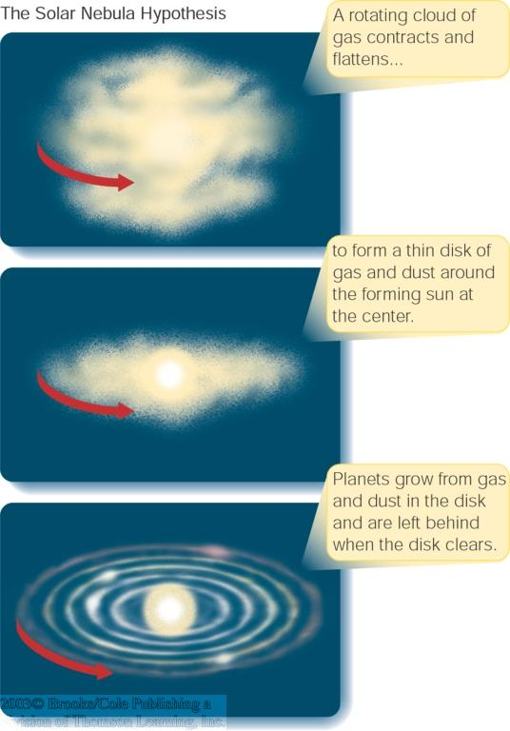
The Solar Nebula Hypothesis
Basis of modern theory of planet formation.
Planets form at the same time from the same cloud as the star.
Planet formation sites observed today as dust disks of T Tauri stars.
Sun and our Solar system formed ~ 5 billion years ago.

Slide 8
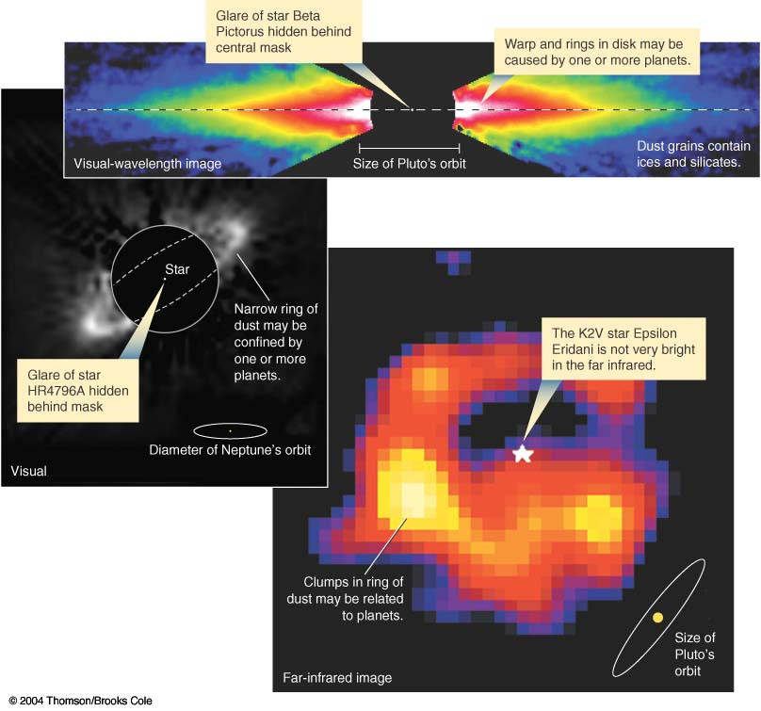
Extrasolar Planets
Modern theory of planet formation is evolutionary
→ Many stars should have planets!
→ planets orbiting around other stars = “Extrasolar planets”
Extrasolar planets can not be imaged directly.
Detection using same methods as in binary star systems:
Look for “wobbling” motion of the star around the common center of mass.

Slide 9
What is a planet?
In August of 2007 the International Astronomical Union redefined what a planet is (no official scientific definition of a "planet" existed before). A planet:
Is a body that orbits the sun (this definition only applies to our Solar System)
Is large enough for its own gravity to make it round
And has "cleared its neighborhood" of smaller objects
So a new the category of dwarf planet was created, which currently includes Pluto, Eris*, and Ceres**.
*Eris is the largest known dwarf planet in the Solar System and the ninth largest body known to orbit the Sun. Its distance from the Sun is 97 AU.
**Ceres is the smallest identified dwarf planet in the Solar System and,
because it’s the largest asteroid, the only dwarf planet in the asteroid belt.

Slide 10
What is a Dwarf Planet?
Celestial body orbiting the Sun
Massive enough to be rounded by its own gravity
BUT has NOT cleared its neighboring region of planetesimals
Is not a satellite
A plutoid is a dwarf planet beyond the orbit of Neptune

Slide 11
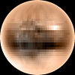

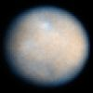


Only 5 Dwarf Planets recognized so far but there may be as many as 200
Pluto, approximate
true color
Makemake,
(Artist’s conception)
Ceres, seen through
(Hubble telescope)
Eris, seen through
(Hubble telescope)
Haumea, with its 2 moons,
Hi‘iaka and Namaka
(Artist’s conception)
Notes:
Ask student to identify which dwarf planets are plutoids

Slide 12
3. What are Small Solar System Bodies?
Neither a planet nor a dwarf planet
All other objects orbiting the Sun
    All minor planets except dwarf planets
    Asteroids (except Ceres, the largest)
    Comets
Not massive enough to be rounded by its own gravity

Slide 13
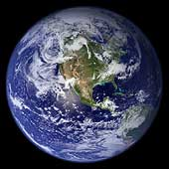
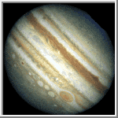
Terrestrial vs. Gaseous Planets
Terrestrial
Gaseous
Jupiter, Saturn, Uranus, Neptune
Gaseous, has more He and H
  Less dense (Saturn would float)
Larger
Spaced farther apart
Farther from the Sun
Mercury, Venus, Earth, Mars
Rocky
  More dense
Smaller
More closely spaced
Closer to the Sun
Notes:
NOTES: He = helium; H = hydrogen

Slide 14
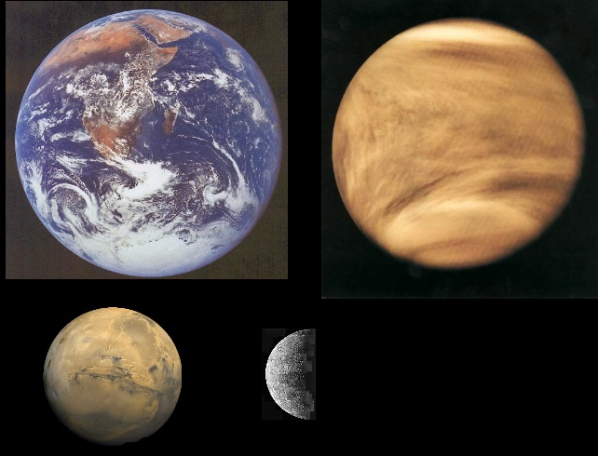
Terrestrial Planets
Mars
Venus
Mercury
From Nick Strobel’s Astronomy Notes at www.astronomynotes.com
Notes:
From http://www.astronomynotes.com/solarsys/s2.htm
This page was copied from Nick Strobel's Astronomy Notes. Go to his site at www.astronomynotes.com for the updated and corrected version.

Slide 15
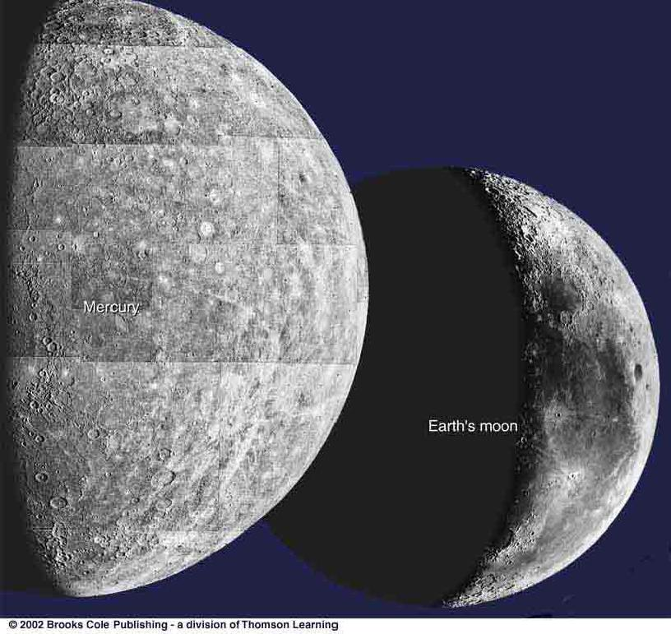
Craters on Planets’ Surfaces
Craters (like on our Moon’s surface) are common throughout the Solar System.
Not seen on Jovian planets because they don’t have a solid surface.

Slide 16
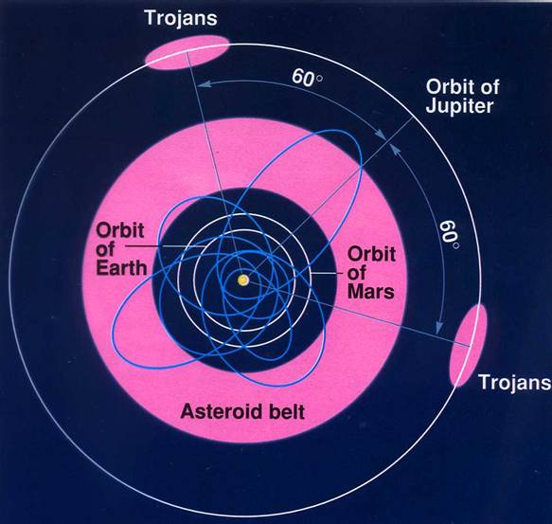
The Asteroid Belt

Slide 17
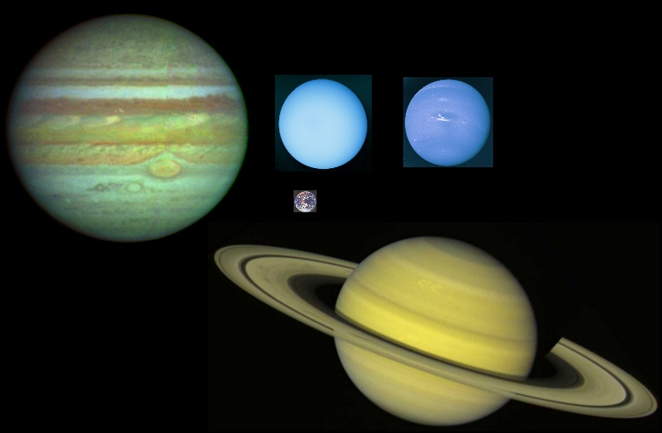
Jovian Planets, or Gas Giants
Uranus
Neptune
Saturn
Jupiter
From Nick Strobel’s Astronomy Notes at www.astronomynotes.com
Notes:
From http://www.astronomynotes.com/solarsys/s2.htm
This page was copied from Nick Strobel's Astronomy Notes. Go to his site at www.astronomynotes.com for the updated and corrected version.

Slide 18
Pluto – a dwarf planet
Pluto is weird.
It’s not very big, and its orbit is very strange.
It’s not a gas giant – it seems to be made of rock and ice.
Maybe it was captured by Neptune.
Some astronomers say it isn’t really a planet.

Slide 19
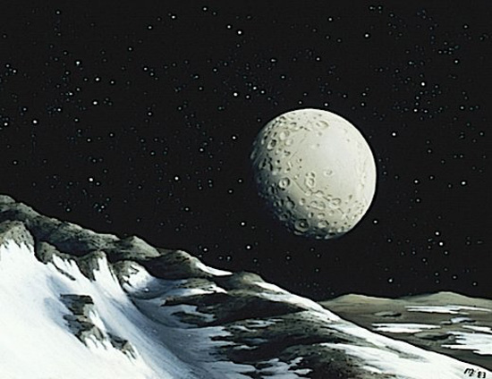
Pluto (seen from Charon)

Slide 20
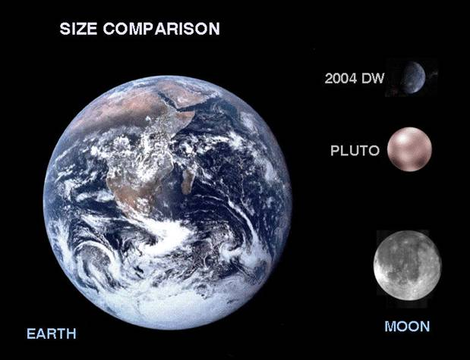
How Big is Pluto ?

Slide 21
WHAT’S OUT THERE
BEYOND
PLUTO ??

Slide 22
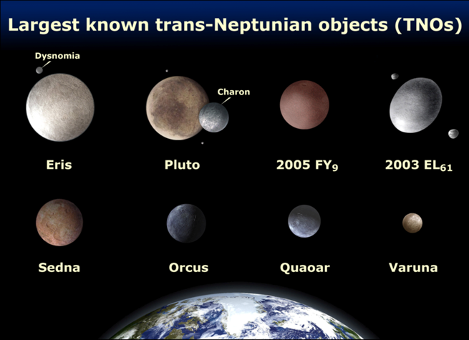
Trans-Neptune Objects (TNOs)
Thanks to Marty Mulroe

Slide 23
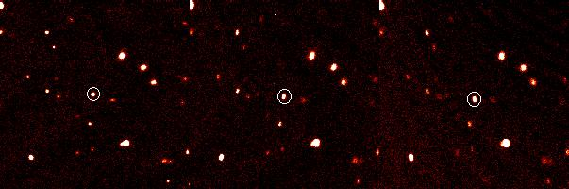
Eris – a dwarf planet
(formerly 2003 UB313)

Slide 24
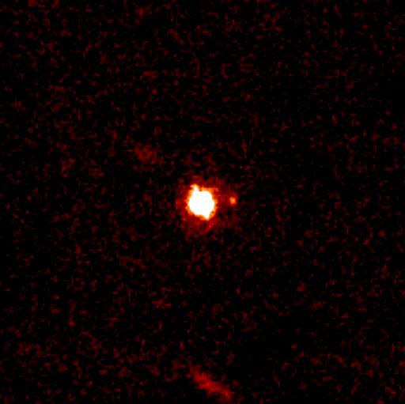
Eris and Dysnomia
Thanks to Marty Mulroe

Slide 25
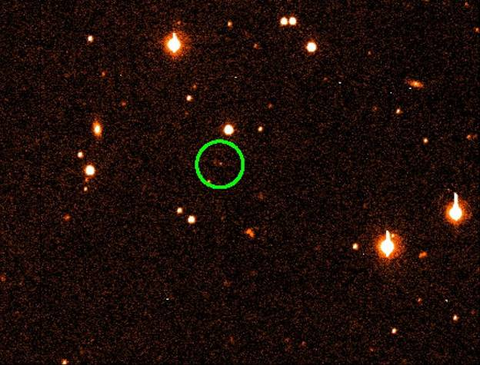
Sedna (Nov 2003)

Slide 26
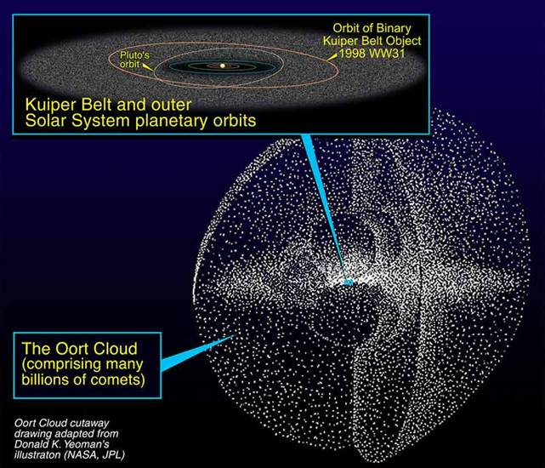
Oort Cloud = Comets

Slide 27
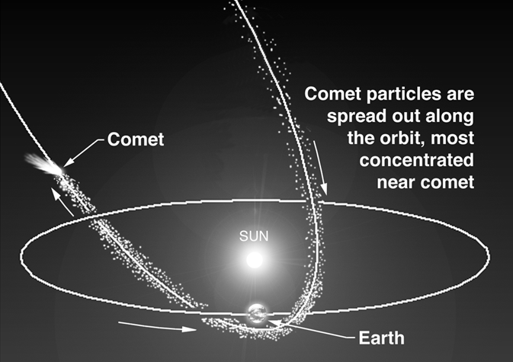
Orbit of a Comet

Slide 28
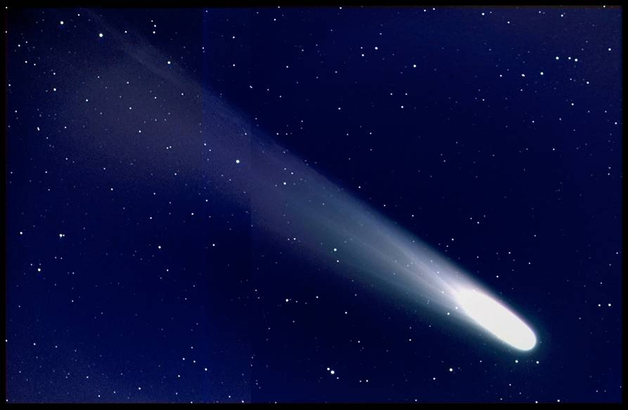
Comet

Slide 29
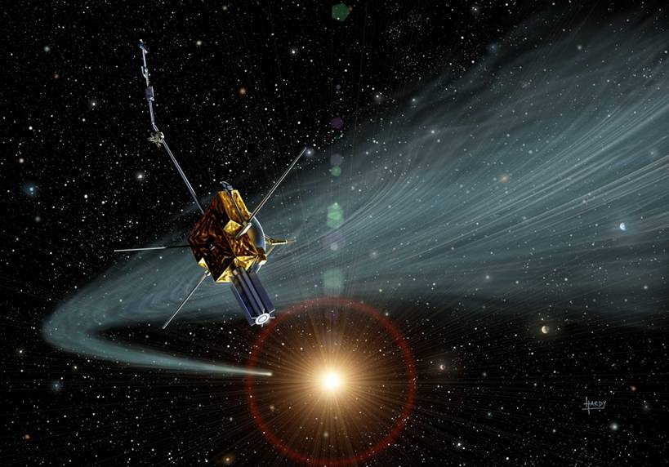
Tail of a Comet

Slide 30
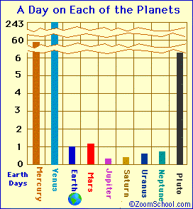
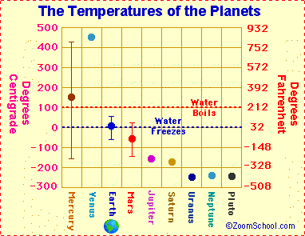
Do you see patterns or anomalies in these data?
Notes:
ANSWERS: Students may notice planets in the middle of the solar system have less extreme temperatures and shorter days compared to those closest and farthest from the sun. Venus’ data is very extreme compared to its neighbors. Pluto’s long day also stands out compared to its neighbors.
From http://www.enchantedlearning.com/subjects/astronomy/planets/

Slide 31
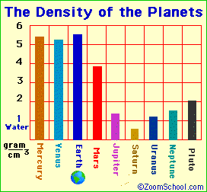
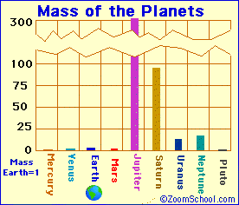
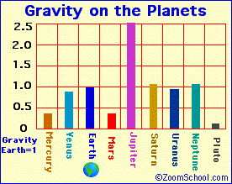
On which planet would you weigh the most?
Notes:
From http://www.enchantedlearning.com/subjects/astronomy/planets/

Slide 32
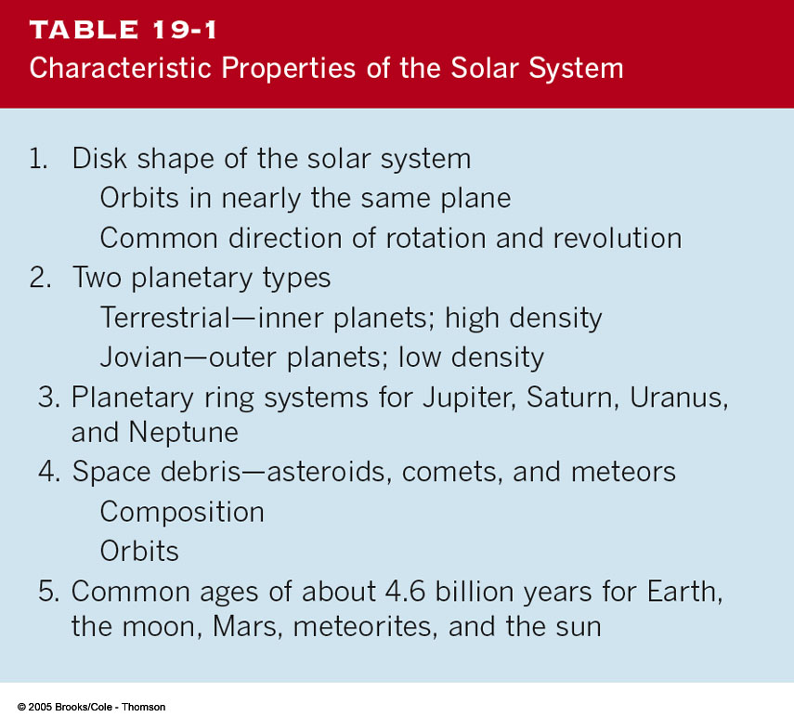
Our Solar System

Slide 33
WHAT DID YOU KNOW?
How many stars are there in the solar system?
Only one star, the Sun.

Slide 34
WHAT DID YOU KNOW?
Is Pluto always the farthest planet from the Sun?
No. Pluto’s orbit is highly eccentric, bringing the planet inside Neptune’s orbit for about 20 years every 250 years.
What typical shapes do moons have?
Most look roughly like potatoes.
Have any Earth-like planets been discovered orbiting Sun-like stars?
No. Nearly all the planets orbiting Sun-like stars are Jupiter-like gas giants.

Slide 35
WHAT DO YOU THINK?
Which of the two planets, Mercury (the closest planet to the Sun) or Earth, has the coolest temperature?
Which planet is most similar to Earth?
What is the composition of the clouds surrounding Venus?
Does Mars have liquid water on its surface today?
Is life known to exist on Mars today?

Slide 36
You will discover…
that Mercury is a Sun-scorched planet with a heavily cratered surface and a substantial iron core
that Venus is perpetually shrouded in thick, poisonous clouds and mostly covered by gently rolling hills
that Mars is the inspiration for scientific and popular speculation about extraterrestrial life

Slide 37
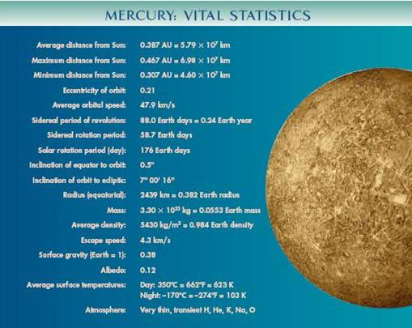

Slide 38
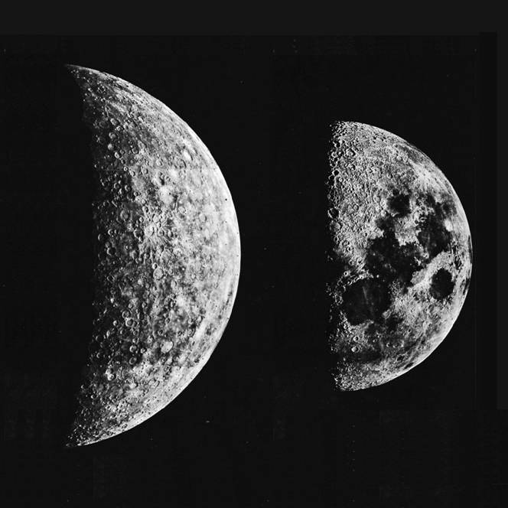
Mercury is only Slightly Larger
than the Moon
OUR MOON
MERCURY

Slide 39
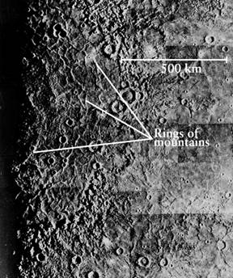
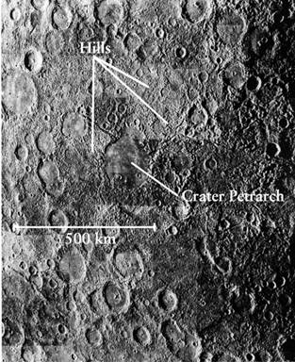
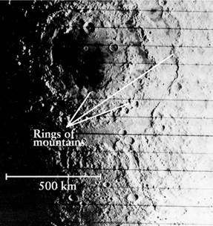
Impact craters on Mercury have similar features to those on the Moon.
CRATERS ON BOTH MERCURY AND THE MOON HAVE RINGS OF MOUNTAINS SURROUNDING THEM
MERCURY
Jumbled hills surrounding the Caloris Impact Basin
OUR MOON

Slide 40
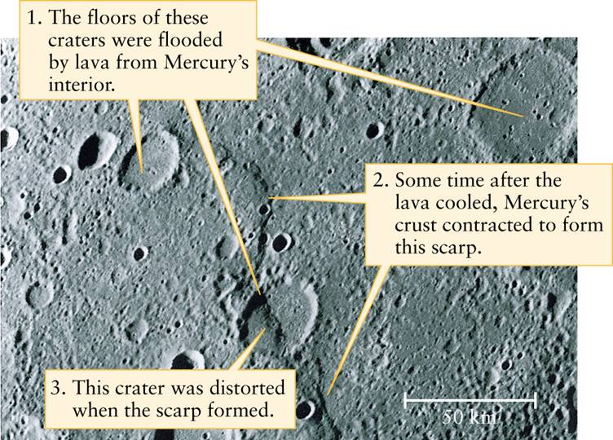
Mercury also has numerous long cliffs, called scarps, believed to have formed when the planet cooled

Slide 41
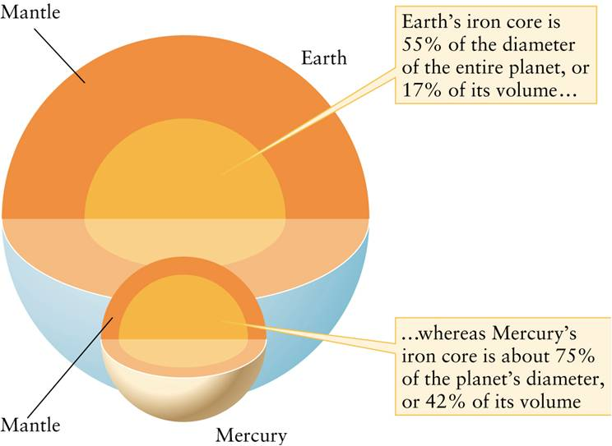
Mercury’s iron core takes up a much larger percentage of its volume than that of Earth.

Slide 42
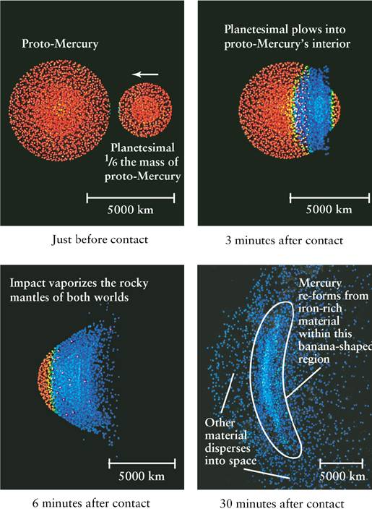
One possible theory to explain Mercury’s high iron content is a collision with a massive asteroid that stripped Mercury of most of its rocky mantle.

Slide 43
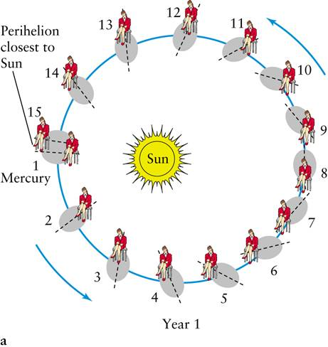
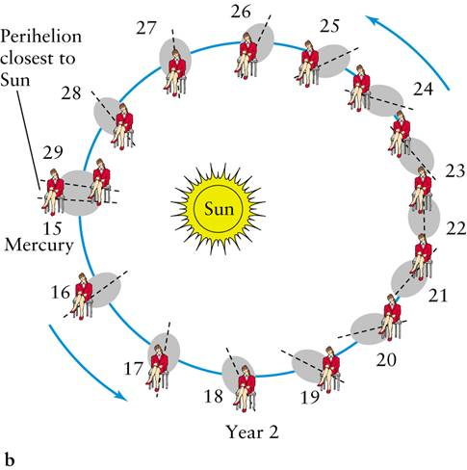
Mercury’s rotation is coupled with its orbital period around the Sun. There are three sidereal rotations of Mercury for every two orbits around the Sun. This unique combination makes a “solar day” on Mercury last two Mercury years.

Slide 44
Other Mercury Stuff
Mercury has a magnetic field 1% as strong as Earth’s, but its source is not known.
Mercury has no permanent atmosphere. Why is that?
Mercury’s surface temperature range is the biggest in the Solar System:
  Noon = 700 K (800 F)
  Night = 100 K (-280 F)

Slide 45
New Space Mission to Mercury
The Messenger spacecraft was launched in 2004, and will reach Mercury orbit in 2011.
On its way to Mercury, Messenger will loop around Venus twice and around Mercury three times. Then it will enter orbit around Mercury.
Why are we making Messenger do loops around Venus and Mercury?

Slide 46
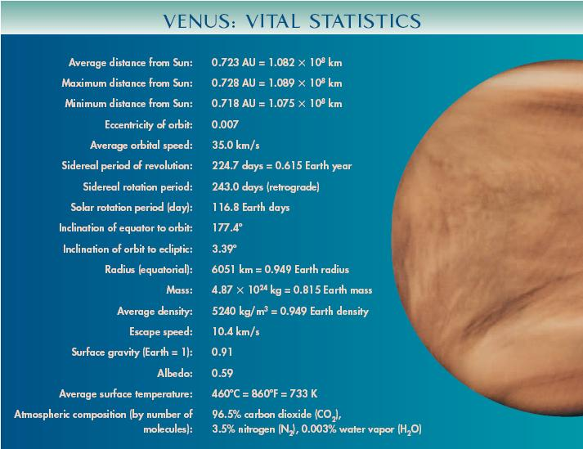

Slide 47
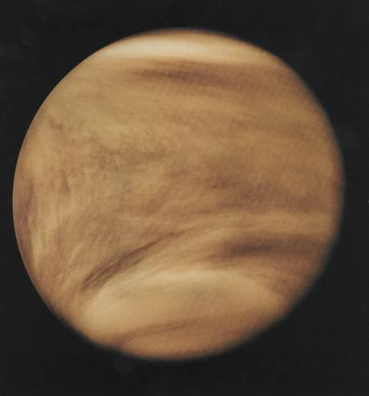
The Clouds of Venus
Venus is covered with a dense layer of clouds that hides its surface.
Unlike the benign water vapor clouds on Earth, these clouds contain large amounts of sulfur dust and sulfur compounds, giving them a yellow-orange color.
The clouds on Venus are made of concentrated sulfuric acid.

Slide 48
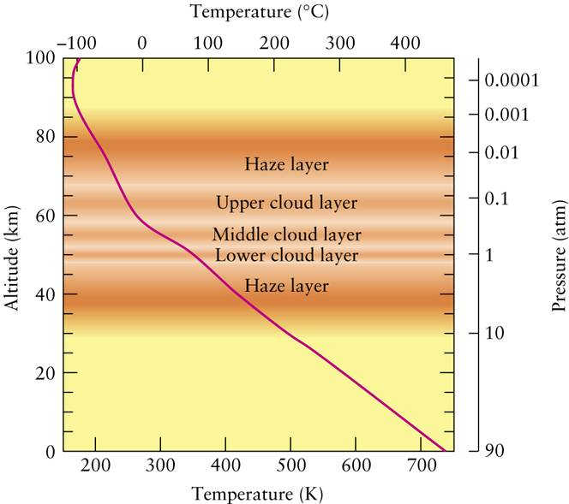
We see dramatic increases in both pressure and temperature as we approach the surface of Venus.
At the surface, the temperature is an astounding 860°F, even hotter than Mercury.

Slide 49
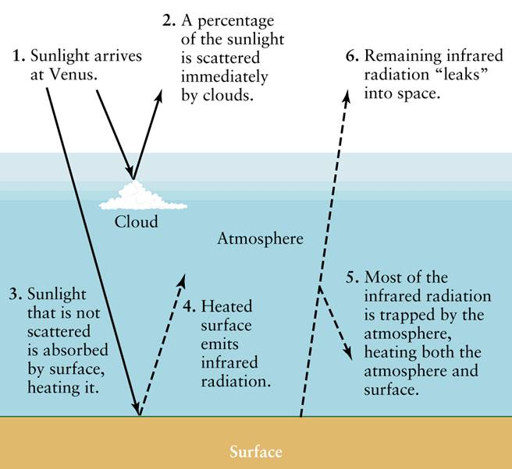
The extreme heating of Venus’ surface is caused by the greenhouse effect
The carbon dioxide in the atmosphere of Venus acts as a “greenhouse,” trapping the heat from the Sun underneath and the temperature rising until finally thermal equilibrium is reached…when the surface is 860°F!

Slide 50
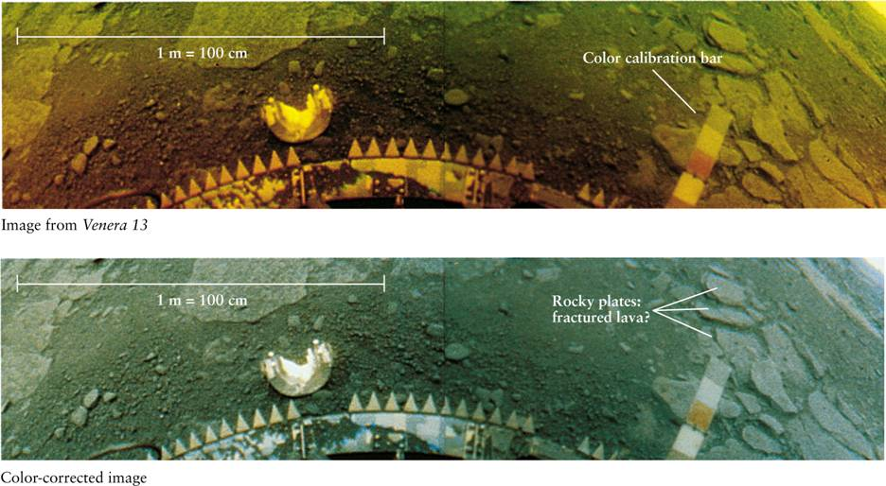
This image of Venus’s surface from the Soviet spacecraft Venera 13 shows rock plates that may be fractured lava.
Unfortunately, this craft was destroyed by the intense pressure and extreme temperatures on the Venusian surface.

Slide 51
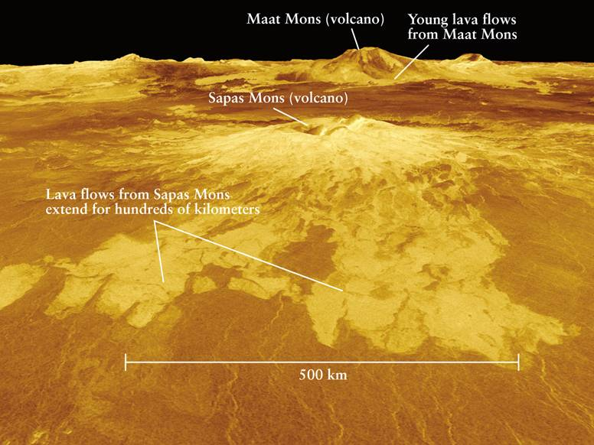
The Magellan spacecraft, in an orbit around Venus, was able to “see through” the thick clouds using radar, giving us the best view of our sister planet.

Slide 52
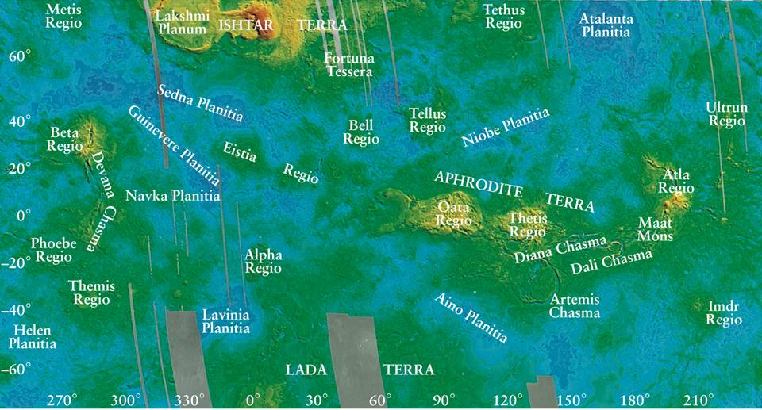
This false color map of Venus, equivalent to a topographical map of Earth, shows the large-scale surface features of the planet.

Slide 53
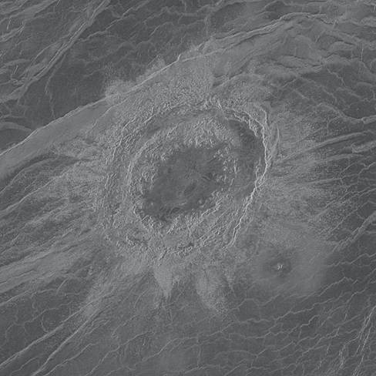

A global view of Venus using radar images from the Magellan spacecraft
The craters found on Venus tend to be in clusters.
This suggests that they were formed from a large single piece of falling debris that was broken up by Venus’s atmosphere.

Slide 54


Slide 55


Mars has been the Center of Speculation about Extraterrestrial Life
People feared an attack from Mars, like this one portrayed in “The War of the Worlds.”
Early telescope images showed features which were perceived as irrigation canals.

Slide 56

Topographical Map of Mars

Slide 57

What are these ?

Slide 58

The Martian surface includes broad towering volcanoes, vast windswept plains, and enormous canyons.
Valles Marineris is a vast canyon stretchimg over about one-fifth the circumference of Mars (as wide as the United States).

Slide 59

Mars also has volcanoes. The largest of these is Olympus Mons. It covers an area the size of Missouri and rises three times higher than Mount Everest.

Slide 60

Thanks to
Will Lynch

Slide 61

Thanks
to
Will
Lynch

Slide 62

Impact Craters on Mars
Most of these craters are found in the Southern Hemisphere, suggesting that the Northern Hemisphere has been resurfaced.

Slide 63


The Martian surface also has some unusual features
Apparent “face” on the Martian surface.
22 years later, with improved technology, the feature looks more natural.

Slide 64

Martian Seasons
Mars is tilted on its axis by 25.19° (nearly the same as Earth) and the hemispheres experience seasons that can be observed by examining the polar caps.
Large ice cap made mostly of frozen carbon dioxide (dry ice)
The dry ice sublimates, leaving a much smaller polar cap

Slide 65

Water Ice – North Pole – Phoenix Lander

Slide 66


Although it is sometimes blue, the Martian sky generally takes on a rust color because of dust particles blown into the atmosphere by strong winds.

Slide 67


High winds create dust devils on the Martian surface.
DARK STREAKS SHOW THE PATH OF DUST DEVILS
A DUST DEVIL FROM ABOVE

Slide 68

By studying the rocks found in the craters on Mars, we hope to gain insight into the history of Martian water.
The crater Endurance, photographed by the Martian rover “Opportunity”

Slide 69


The winding canyons found on the Martian surface are similar to those found in river beds on Earth, suggesting that liquid water once flowed on Mars.
Martian winding canyon, photographed by the Viking orbiter
The Yangtze River in China has similar features

Slide 70



Surface features believed to be ancient waterways
A dried riverbed
An ancient lake
Sedimentation

Slide 71



Layers of rock laid down by water
Hematite black rocks, usually formed in water
Gullies in crater walls

Slide 72

Did Mars once support life? Is there life there now?
Viking’s mechanical arms collect samples of the Martian soil to analyze its chemical makeup and to search for possible signs of microscopic life.

Slide 73

SNC meteorites are believed to have come from Mars, because their chemistry is consistent with that of the Martian climate. These would have been ejected from Mars during a major impact.
These rocks show possible fossils of microbial life. However, they also have possible non-biological explanations.

Slide 74

The two moons of Mars, Deimos and Phobos, are small and non-spherical in shape. These are planetesimals captured by Mars.

Slide 75


Slide 76


Slide 77
WHAT DID YOU THINK?
Which of the two planets, Mercury (the closest planet to the Sun) or Earth, has the coolest temperature?
The daytime temperature of Mercury is much higher than on Earth, but the nighttime temperature of Mercury is much lower than on Earth.
Which planet is most similar to Earth?
Venus is most similar in size, chemistry, and distance from the Sun. Mars is most similar in its length of day, seasons, erosion, and in having water ice.
What is the composition of the clouds surrounding Venus?
The clouds are made primarily of sulfuric acid.

Slide 78
WHAT DID YOU THINK?
Does Mars have liquid water on its surface today?
No, but there are strong indications that it had liquid water in the past.
Is life known to exist on Mars today?
No current life has yet been discovered on Mars.

